Slide 1
Curse of Democracy: Evidence from 2020
Yusuke Narita
Ayumi Sudo

Slide 2
Notes:
In 2020, GDP growth rate in China was 2.3%, while the US GDP growth rate is -3.5%, the worst since WW2.

Slide 3
Notes:
If we look at the number of Covid-19-related deaths per million, the difference is even more apparent.
China: 3.4
US: 1070
Even if we doubled, tripled or even multiplied this statistic by 100, it would still be very far from the total number of Covid-19 deaths per million in the US.

Slide 4

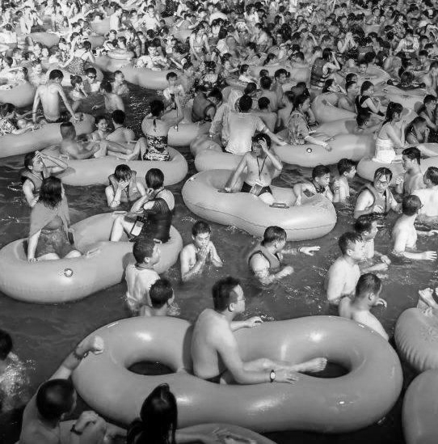
United States
China
Notes:
Explaining such vast differences in economic and health performance is a pressing issue for today’s world.
An obvious distinction between the US and China is in whether the political system is democratic or autocratic. Democracy is widely believed to promote economic prosperity and the safety of life, but whether democracy causes better outcomes is becoming increasingly debatable. In 2020 and 2021, the US along with other major democracies such as the UK and France face historic recessions and death tolls.
The democratic countries stand in stark contrast to China and other autocratic countries, posing a natural question:
// Despite the surge in vaccinations in recent months, especially in the US, the UK and Israel, it does not allow us to turn away from the countless lives lost in the worst year for humans since WW2.

Slide 5
Are democracies hampered by inherent inefficiency and political division – or do their openness and diversity make for a more effective mobilization…?
The New York Times, “The Virus Comes for Democracy,”
April 2, 2020
Notes:
This situation begs the question, as succinctly articulated by the New York Times, in April last year as New York suffered, “Are democracies hampered by inherent inefficiency and political division -- or do their openness and diversity make for a more effective mobilization??”

Slide 6
Question and empirical strategy
Context: Democracy is associated with negative economic growth and more Covid-19 deaths in 2020
Question: Did democratic political regimes cause the worse economic and public health outcomes?
Empirical strategy: Use five of the most influential instruments for political and social institutions
Notes:
This is the question that we answer in this paper.
Given the context that democracy is strongly associated with worse economic and health outomes in 2020, we ask whether democracy CAUSED these worse outcomes. To do so, we use fve of the ost influential instruments for political and social institutions.

Slide 7
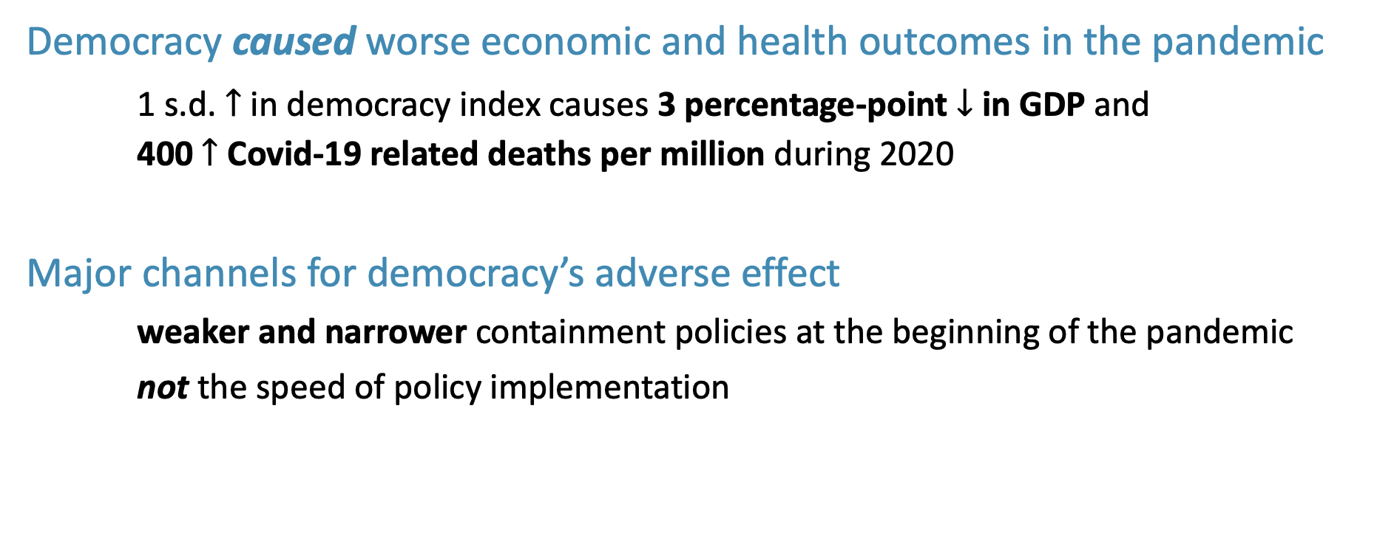
Preview of findings
Democracy caused worse economic and health outcomes in the pandemic
1 s.d. $↑$ in democracy index causes 3 percentage-point $↓$ in GDP and
400 $↑$ Covid-19 related deaths per million during 2020
Major channels for democracy’s adverse effect
weaker and narrower containment policies at the beginning of the pandemic
not the speed of policy implementation
Notes:
We find that:
Democracy did cause the worse economic and health outcomes in the pandemic.
a standard deviation increase
a standard deviation difference in democratic levels is equivalent to the political regime difference between Iraq and Indonesia, or Indonesia and France.
The channels behind democracy’s adverse effect

Slide 8
Literature review
1. Democracy, economic growth and public health
2. Economics of pandemics
Notes:
Our work is at the intersection of two strands of the literature: the relationship among democracy, economic growth, and public health, and the economics of pandemics.

Slide 9
1a. Democracy, economic growth and public health
Difficult to identify
Klenow and Rodriguez-Clare (1997); Helpman (2009)
Classic cross-sectional regression studies
Barro (1997); Przeworski and Limongi (1993); Przeworski et al. (2000)
More quasi-experimental research designs
Acemoglu et al. (2018); Papaioannou and Siourounis (2008); Persson and Tabellini (2006); Quinn and Woolley (2001); Rodrik and Wacziarg (2005)
Democracy’s effect on health
Besley and Kudamatsu (2006); Kudamatsu (2012)
More broadly defined Western institutions
Acemoglu, Johnson and Robinson (2001, 2002); Easterly and Levine (2003); Hall and Jones (1999)
Notes:
Any cause of macroeconomic growth and national public health is difficult to identify due to omitted variable biases, measurement errors, and limited data size.
We are not aware of a prior study that shows a substantially negative causal impact of democracy.

Slide 10
1b. Mechanisms behind democracy’s effects
Higher representation leads to greater investments in education and public health
Baum and Lake (2003); Doucouliagos and Ulubasoglu (2008); Lake and Baum (2001); Tavares and Wacziarg (2001)
Different electoral process leads to different income redistribution and provisions of public goods
Besley and Case (2003); Burgess et al. (2015)
Notes:
* We are not aware of a prior study that shows a substantially negative causal impact of democracy.

Slide 11
2. Economics of pandemics
Obedience to travel restrictions or compliance with social distancing differ by culture, social capital, government communication, and political systems
Frey, Chen and Presidente (2020); Giuliano et al (2020); Karabulut et al (2021); Bosancianu et. al (2020); Schmelz (2021)
Notes:
We also contribute to the exploding literature on the economics of pandemics.
Many researchers attempt to explain the cross-country heterogeneity in Covid-19 outcomes.
Studies show that obedience to travel restrictions or compliance with social distancing differ by culture, social capital, government communication, and political systems
However, none of them finds politcal regimes to be the root cause of the heterogeneity in Covid-19 outcomes.

Slide 12
Literature review
1. Democracy, economic growth and public health
No prior study shows a substantially worse effect of democracy
2. Economics of pandemics
No prior study focuses on the causal effect of political regimes
Integrate these two strands to find that democracy causes the worse economic and public health outcomes in 2020.
Notes:
Given this development in the literature, wur work integrates these two strands to find that democracy causes the worse economic and public health outcomes during 2020.
* To our knowledge, this paper seems to be the only study that shows any substantially adverse effect of democracy on any important outcome.

Slide 13
Outline
Data on GDP, Covid-19 deaths, and democracy
OLS relationship between democracy, GDP, and Covid-19 deaths
Instruments for political regimes
Results
Democracy’s causal effect
Channels behind democracy’s effect
Conclusion
Notes:
This presentation will proceed as follows:
1. Describe our data on GDP, Covid-19 deaths, and democracy
2. Explore the OLS relationship between democracy and Covid-19 outcomes to establish that democracy is significantly associated with worse outcomes.
3. Then, we explain our empirical strategy and describe our five different sets of instruments which we use to identify democracy’s effect.
4. After explaining the empirical strategy, we move on to democracy’s causal effect and the channels behind it.
Then, we conclude.

Slide 14
Outline
Data on GDP, Covid-19 deaths, and democracy
OLS relationship between democracy, GDP, and Covid-19 deaths
Instruments for political regimes
Results
Democracy’s causal effect
Channels behind democracy’s effect
Conclusion

Slide 15
Data on GDP and Covid-19 deaths
GDP growth rates in 2020
World Economic Outlook by the International Monetary Fund
Estimates
Total number of deaths per million attributed to Covid-19
Covid-19 Data Repository Center for Systems Science and Engineering at Johns Hopkins University
Local administrative sources
Notes:
In our paper, we focus on two outcomes: the GDP growth rate in 2020 and the total number of deaths per million attributed to Covid-19.
We focus on these two outcomes because they are not only important but also less susceptible to selective reporting than other outcomes, such as the number of COVID-19 cases.
We obtain data for GDP growth rates in 2020 from the World Economic Outlook report by the International Monetary Fund. Note that these are estimates, as the official numbers take a while to be established and publicized in a consistent way.
For the total number of deaths per million attributed to Covid-19, we source data from the Covid-19 repository center for systems science and engineering at Johns Hopkins university. They are cited by many papers and media outlets and source official counts from local administrative sources.

Slide 16
Data on democracy
Baseline measure: Freedom House’s index
Freedom in the World 2020
0 to 4 points for 10 political rights indicators and 15 civil liberties indicators
Widely used in the literature:
Barro (1999); Frey, Chen and Presidente (2020); Spilimbergo (2009); Stepan and Robertson (2003)
Alternative measures produce similar results:
Center for Systemic Peace
Economist Intelligence Unit
Notes:
Next, on our data for democracy.
Measuring the extent of democracy is tricky.
Thankfully, there are several widely accepted indices that attempt to put a number on the levels of democracy around the world in an unbiased manner.
The baseline measure which we adopt is the index released by an international think tank called Freedom House in their report, Freedom in the World 2020.
What they do is to give each country 0 to 4 points for 10 political rights indicators and 15 civil liberties indicators. The democracy index is the sum of these sub-scores.
Although this index is trusted by many scholars in the field, we test the robustness of our results by adopting alternative measures for democracy, namely those by the Center for Systemic Peace and the Economist Intelligence Unit. We find that they provide similar results.

Slide 17
Outline
Data on GDP, Covid-19 deaths, and democracy
OLS relationship between democracy, GDP, and Covid-19 deaths
Instruments for political regimes
Results
Democracy’s causal effect
Channels behind democracy’s effect
Conclusion
Notes:
Now, let’s describe the OLS relationship between democracy and Covid-19 outcomes.

Slide 18
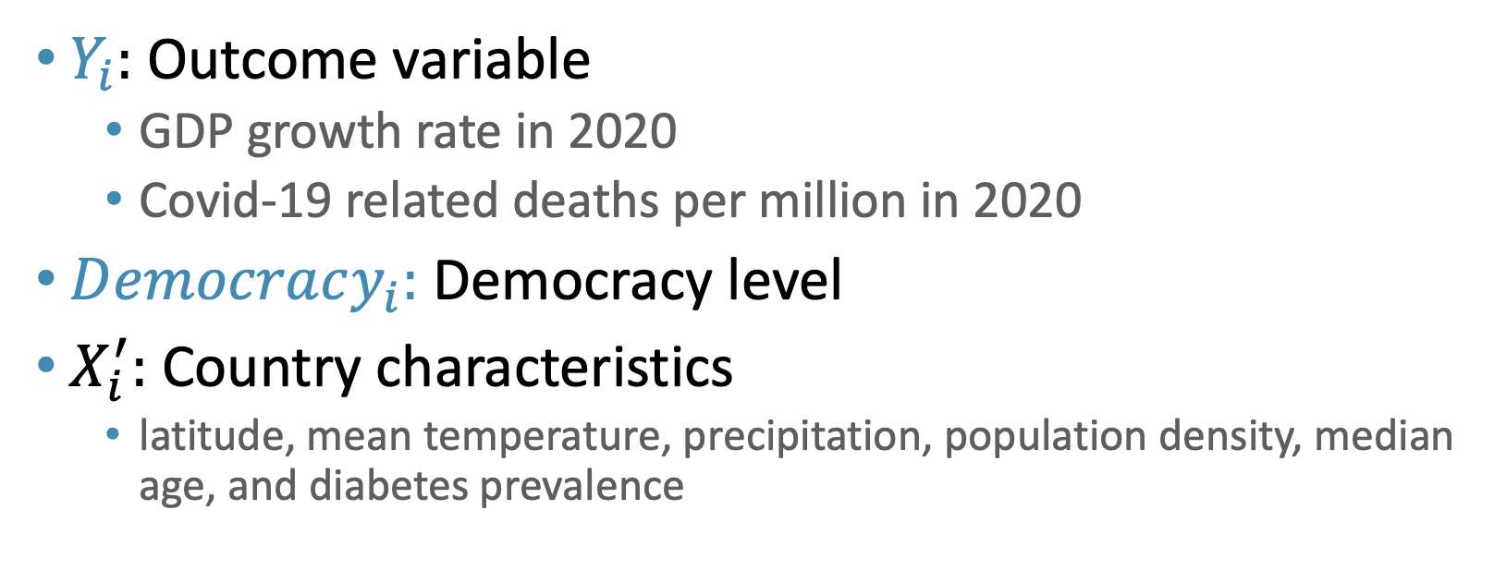
Empirical specification
${ Y}_{i}=μ+αDemocracy_{i}+X_{i}^{′}γ+ε_{i}$
$Y_{i}:$ Outcome variable
GDP growth rate in 2020
Covid-19 related deaths per million in 2020
$Democracy_{i}:$ Democracy level
$X_{i}^{′}:$ Country characteristics
latitude, mean temperature, precipitation, population density, median age, and diabetes prevalence
Notes:
Our simple empirical specification is as follows.
On the left hand side of the equation if our outome variable : either the GDP growth rate in 2020 or the Covid-19-related deaths per million in 2020.
Our main explanatory variable is the level of democracy captured by the democracy index by Freedom House.
We also include controls for other country characteristics that could also determine outcomes in 2020. These are latitude,

Slide 19
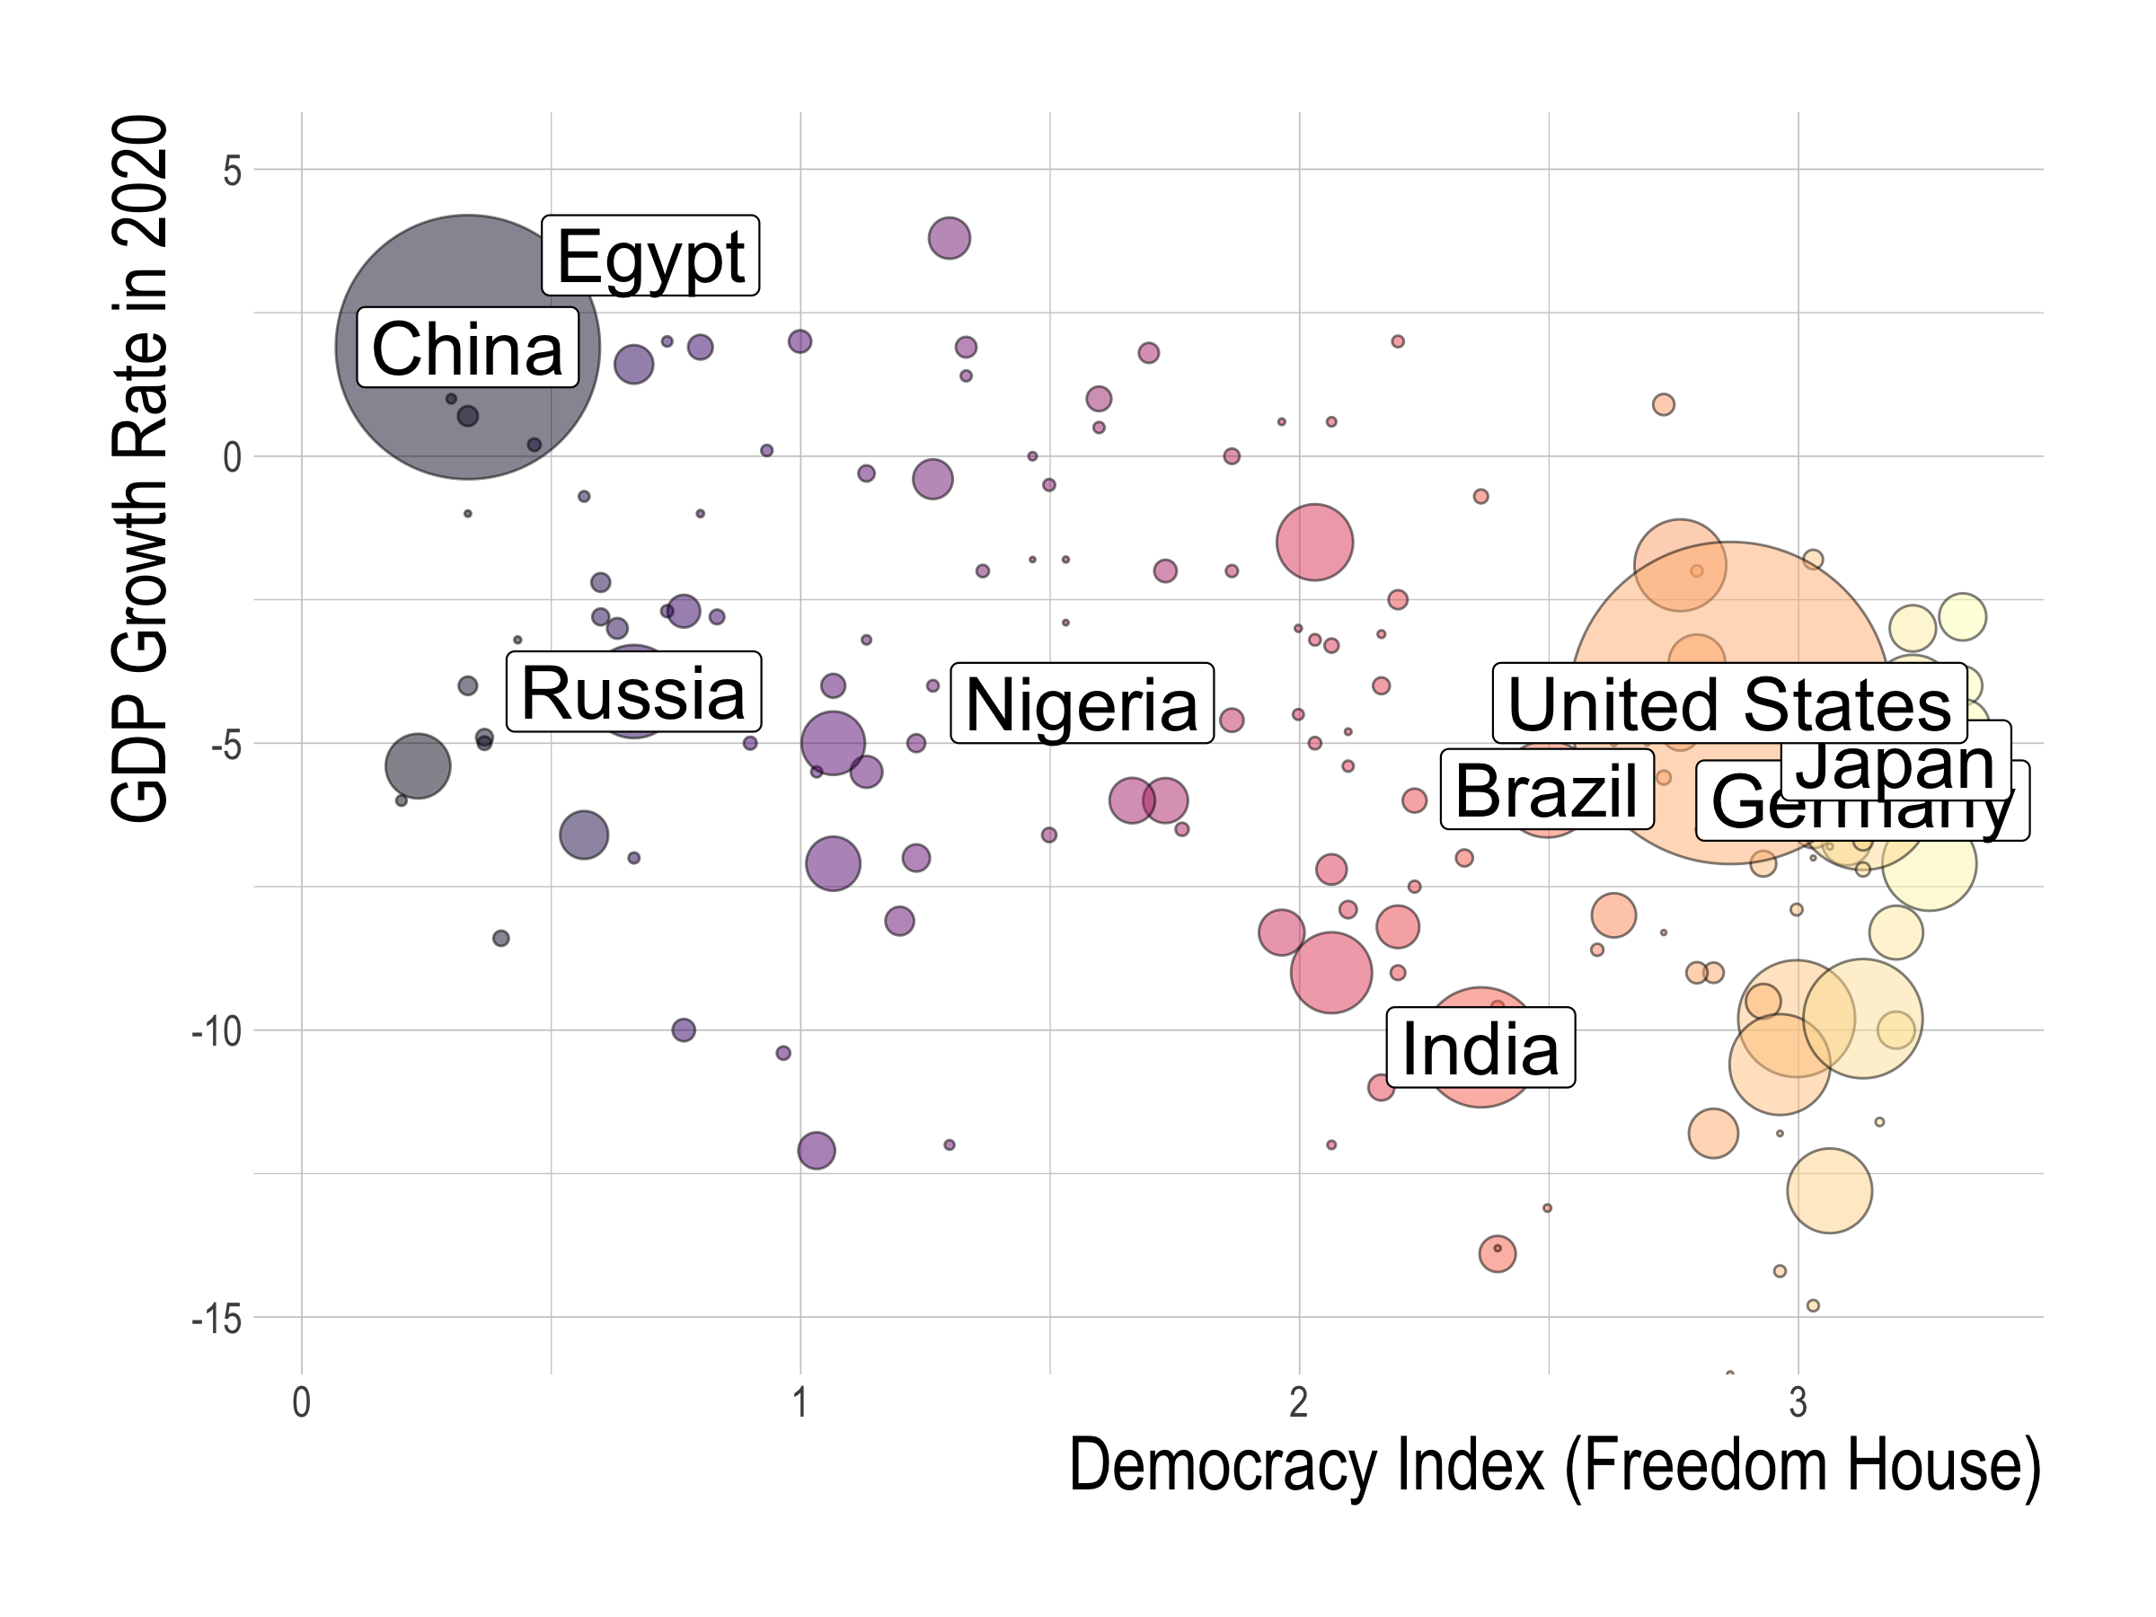
Notes:
This graph shows the relationship between the GDP growth rate in 2020 on the y axis and democratic levels as measured by Freedom House on the x-axis.
Here, we normalize the democracy index so that its standard deviation is one.
The bubbles on the graph correspond to each country, and its size is proportional to its total GDP size.
The colors of each bubble correspond to the democratic level, with warmer colors being associated with higher levels of democracy.
From this graph, we can see that more democratic nations on the right side of the graph experience seem to experience more negative GDP growth rates.

Slide 20
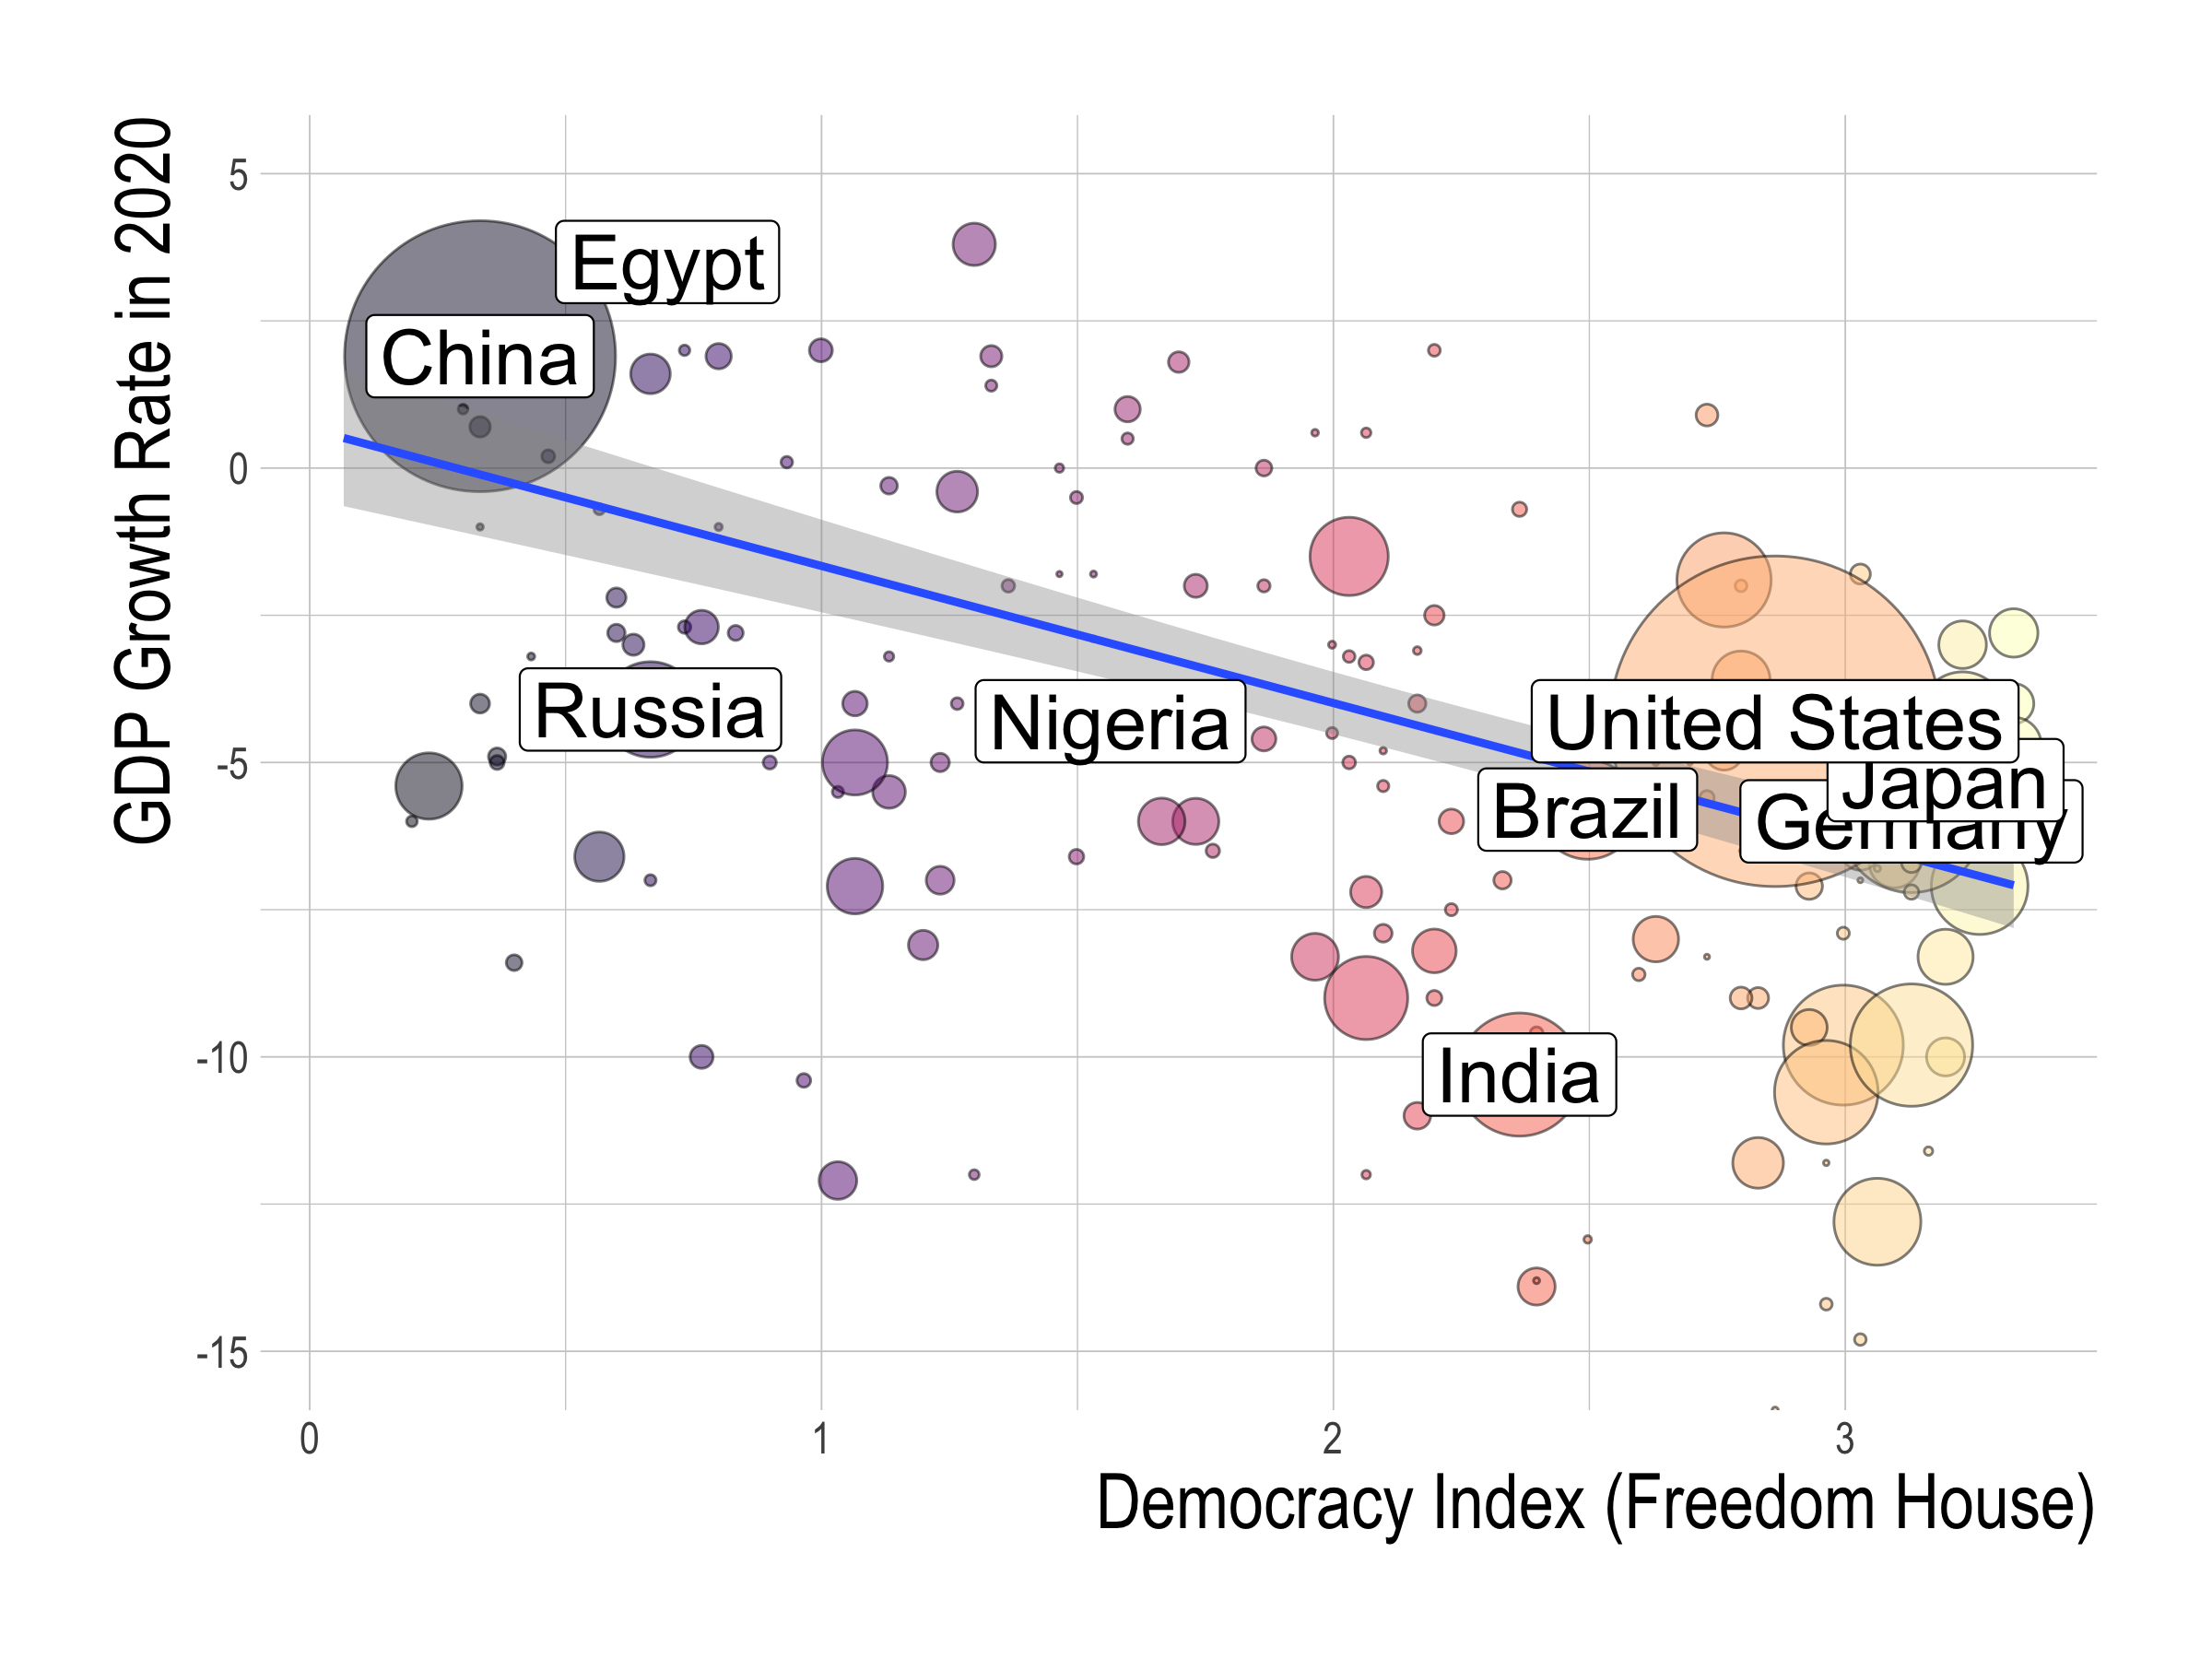
Notes:
This observation is supported by our OLS regression result. This blue line is the fitted OLS regression line that we get with a regression of the democracy index against the GDP growth rate that weights each country by GDP size. The shaded area is the 95% confidence interval.

Slide 21
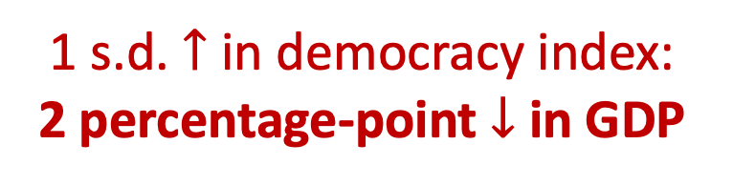
1 s.d. $↑$ in democracy index:
2 percentage-point $↓$ in GDP
Notes:
What we find is that a standard deviation increase in the democracy index is associated with around a 2 percentage-point decrease in GDP between 2019 and 2020. This estimate is statistically significant at the 5% level.
We obtain similar estimates across different samples with and without controls.

Slide 22
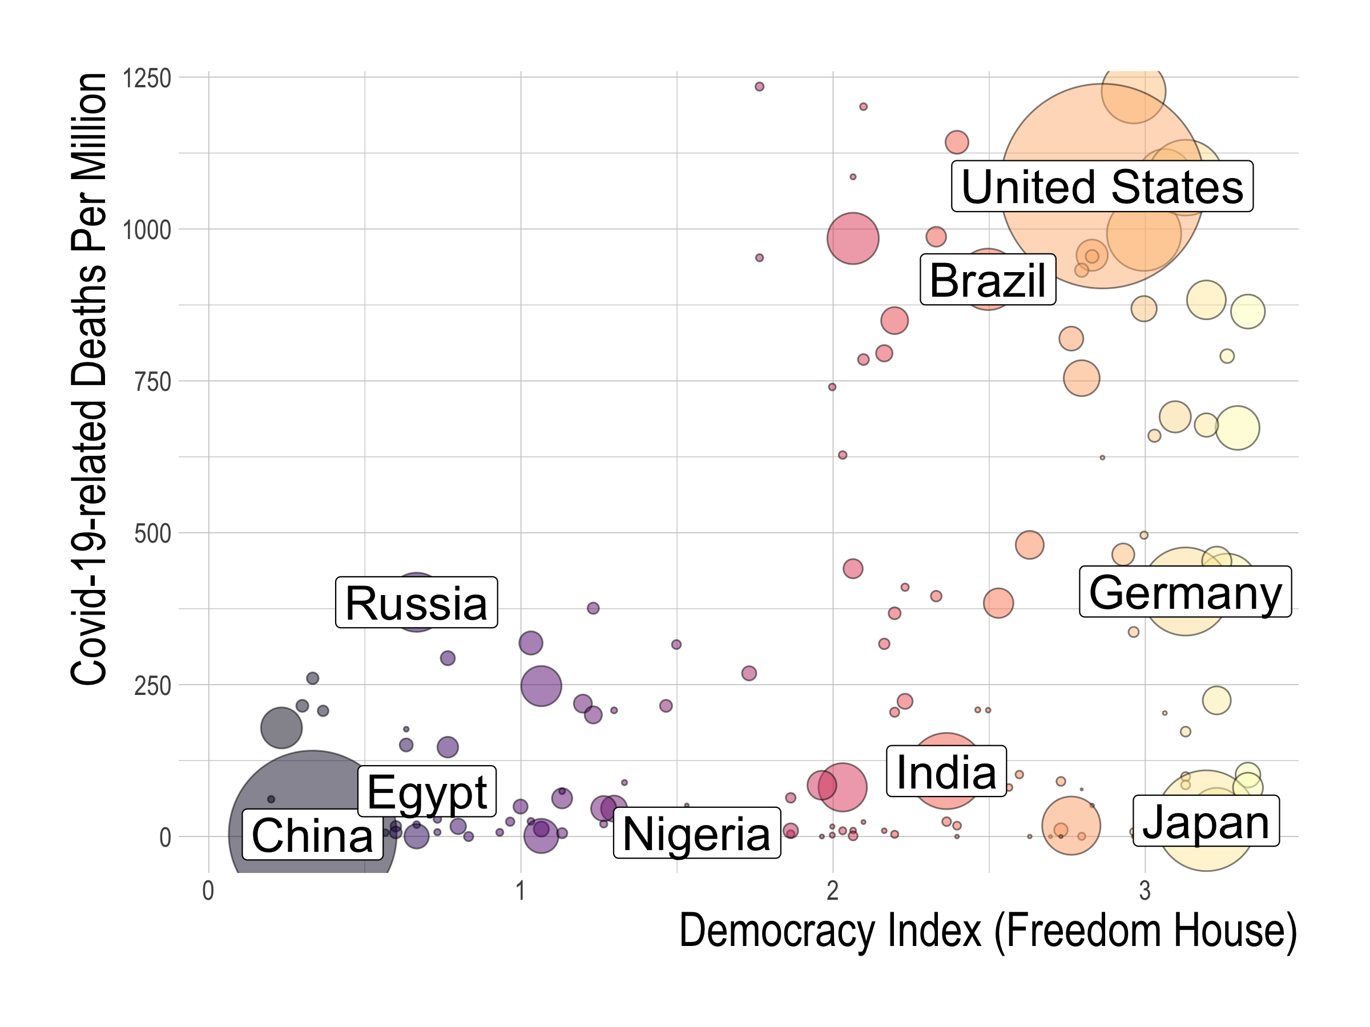
Notes:
What about the correlation between democracy and Covid-19 deaths?
The specifications here are the same as before, except that the y-axis is now the total Covid-19-related deaths per million.

Slide 23
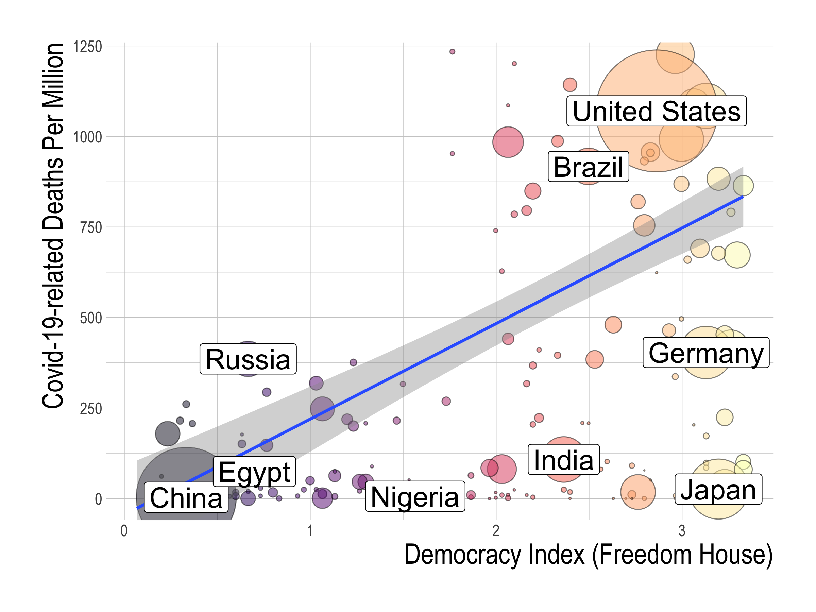
Notes:
Our OLS regression results, as captured by the blue regresison line, shows that higher levels of democracy correspond to more deaths from Covid-19.

Slide 24
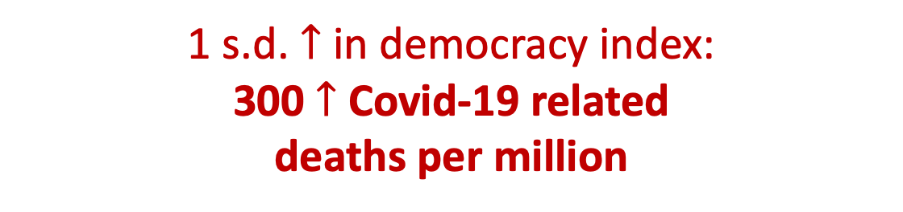
1 s.d. $↑$ in democracy index:
300 $↑$ Covid-19 related
deaths per million
Notes:
In fact, a standard deviation increase in the democracy index corresponds to around 300 more Covid-19-related deaths per million. Again, we obtain similar estimates across different samples with and without controls.

Slide 25
Outline
Data on GDP, Covid-19 deaths, and democracy
OLS relationship between democracy, GDP, and Covid-19 deaths
Instruments for political regimes
Results
Democracy’s causal effect
Channels behind democracy’s effect
Conclusion
Notes:
We cannot interpret the observed OLS relationship as causal, however, because there are likely to be many omitted determinants of outcomes that also correlate with democracies.
Hence, to identify the causal effect of democracy, we adopt five instruments to conduct instrumental variables analysis. Now, we describe these instruments and our empirical strategy in more detail.

Slide 26
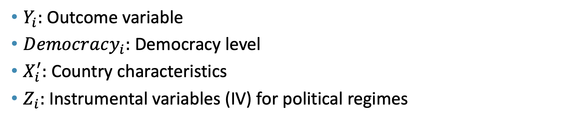
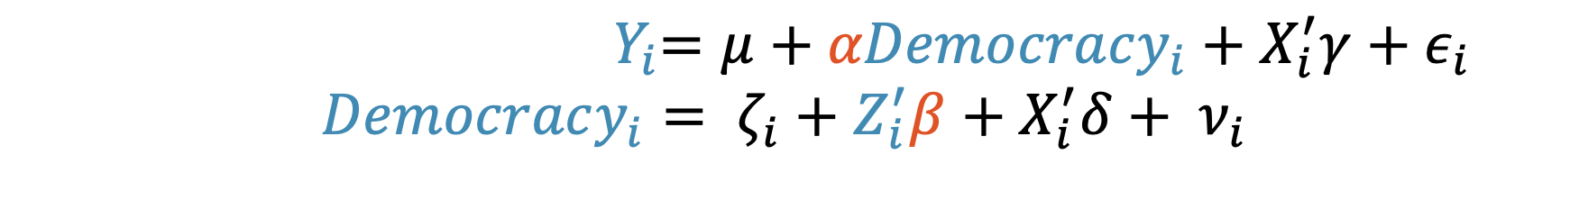
Empirical specification
${ Y}_{i}=μ+αDemocracy_{i}+X_{i}^{′}γ+ε_{i}$
$$Democracy_{i}= ζ_{i}+Z_{i}^{′}β+X_{i}^{′}δ+ ν_{i}$$
$Y_{i}:$ Outcome variable
$Democracy_{i}:$ Democracy level
$X_{i}^{′}:$ Country characteristics
$Z_{i}:$Instrumental variables (IV) for political regimes
Notes:
Our empirical specification is as follows:
The equation at the top, which is our second-stage equation, is the same as our OLS equation, where we have Covid-19 outcomes on the left side, and our main explanatory variable, democracy levels, on the right hand side.
The difference now is that, since democracy is far from randomly assigned, we introduce a first-stage equation that has democracy as the outcome variable and instruments for political regimes, captured by Z, as the main explanatory variable.

Slide 27
Instruments for political regimes
We adopt 5 IVs that consider several centuries of world history
European settler mortality (Acemoglu-Johnson-Robinson 01)
Fraction speaking English or European and the Frankel-Romer trade share (Hall-Jones 99)
Legal origin (LaPorta-Shleifer-Vishny 98)
Availability of crops and minerals (Easterly-Levine 03)
Past population density (AJR 02)
Notes:
So what kind of instruments actually exist? In our paper, we adopt five instrumental variable strategies that considers several centuries of world history. We use these with the expectation that they work as robustness checks against each other.
Five instrumental variables strategies:
European settler mortality
Fraction speaking English or European, and the Frankel-Romer trade share
Legal origin
Availability of crops and minerals
Past population density
These IVs help identify the effects of political institutions by tracing back their origins to geographical and his- torical determinants such as the feasibility and incentives of colonial powers to invest in institution-building, the origin of the legal institution, and natural resource endowments. Indeed, first-stage regressions show that several of these IVs are significant drivers of the cross-country variation in today’s democracy levels.

Slide 28
1. European settler mortality
Acemoglu, Johnson and Robinson (2001)
Mortality rate of European soliders, bishops, and sailors in 17th~19th centuries.
Notes:
First suggested by Acemoglu, Johnson, and Robinson (2001) as an instrument for political and social institutions.
Mortality rate of soldiers, bishops, and sailors stationed in the colonies between the seventeenth and nineteenth centuries.

Slide 29
Higher European settler mortality
Less European settlers
More extractive colonial institutions
Less democractic political institutions
Notes:
Their line of reasoning to justify this instrument is the following:
european settler mortality rates were used by European colonizers to decide on their colonial policy.
Where they observed low mortality rates, they wanted to settle, since it was safer for them. Where they observed higher mortality rates, they did not want to settle.
The fact that Europeans did not want to and did not settle meant that colonizers would make colonial institutions solely for the sake of extracting natural resources from that colony and transfer it to the themselves. This resulted in more extractive colonial institutions that did not protect individual liberties or provide checks against power.
Then, the effect of these colonial institutions persist to the present, and lead to less democratic institutions.

Slide 30
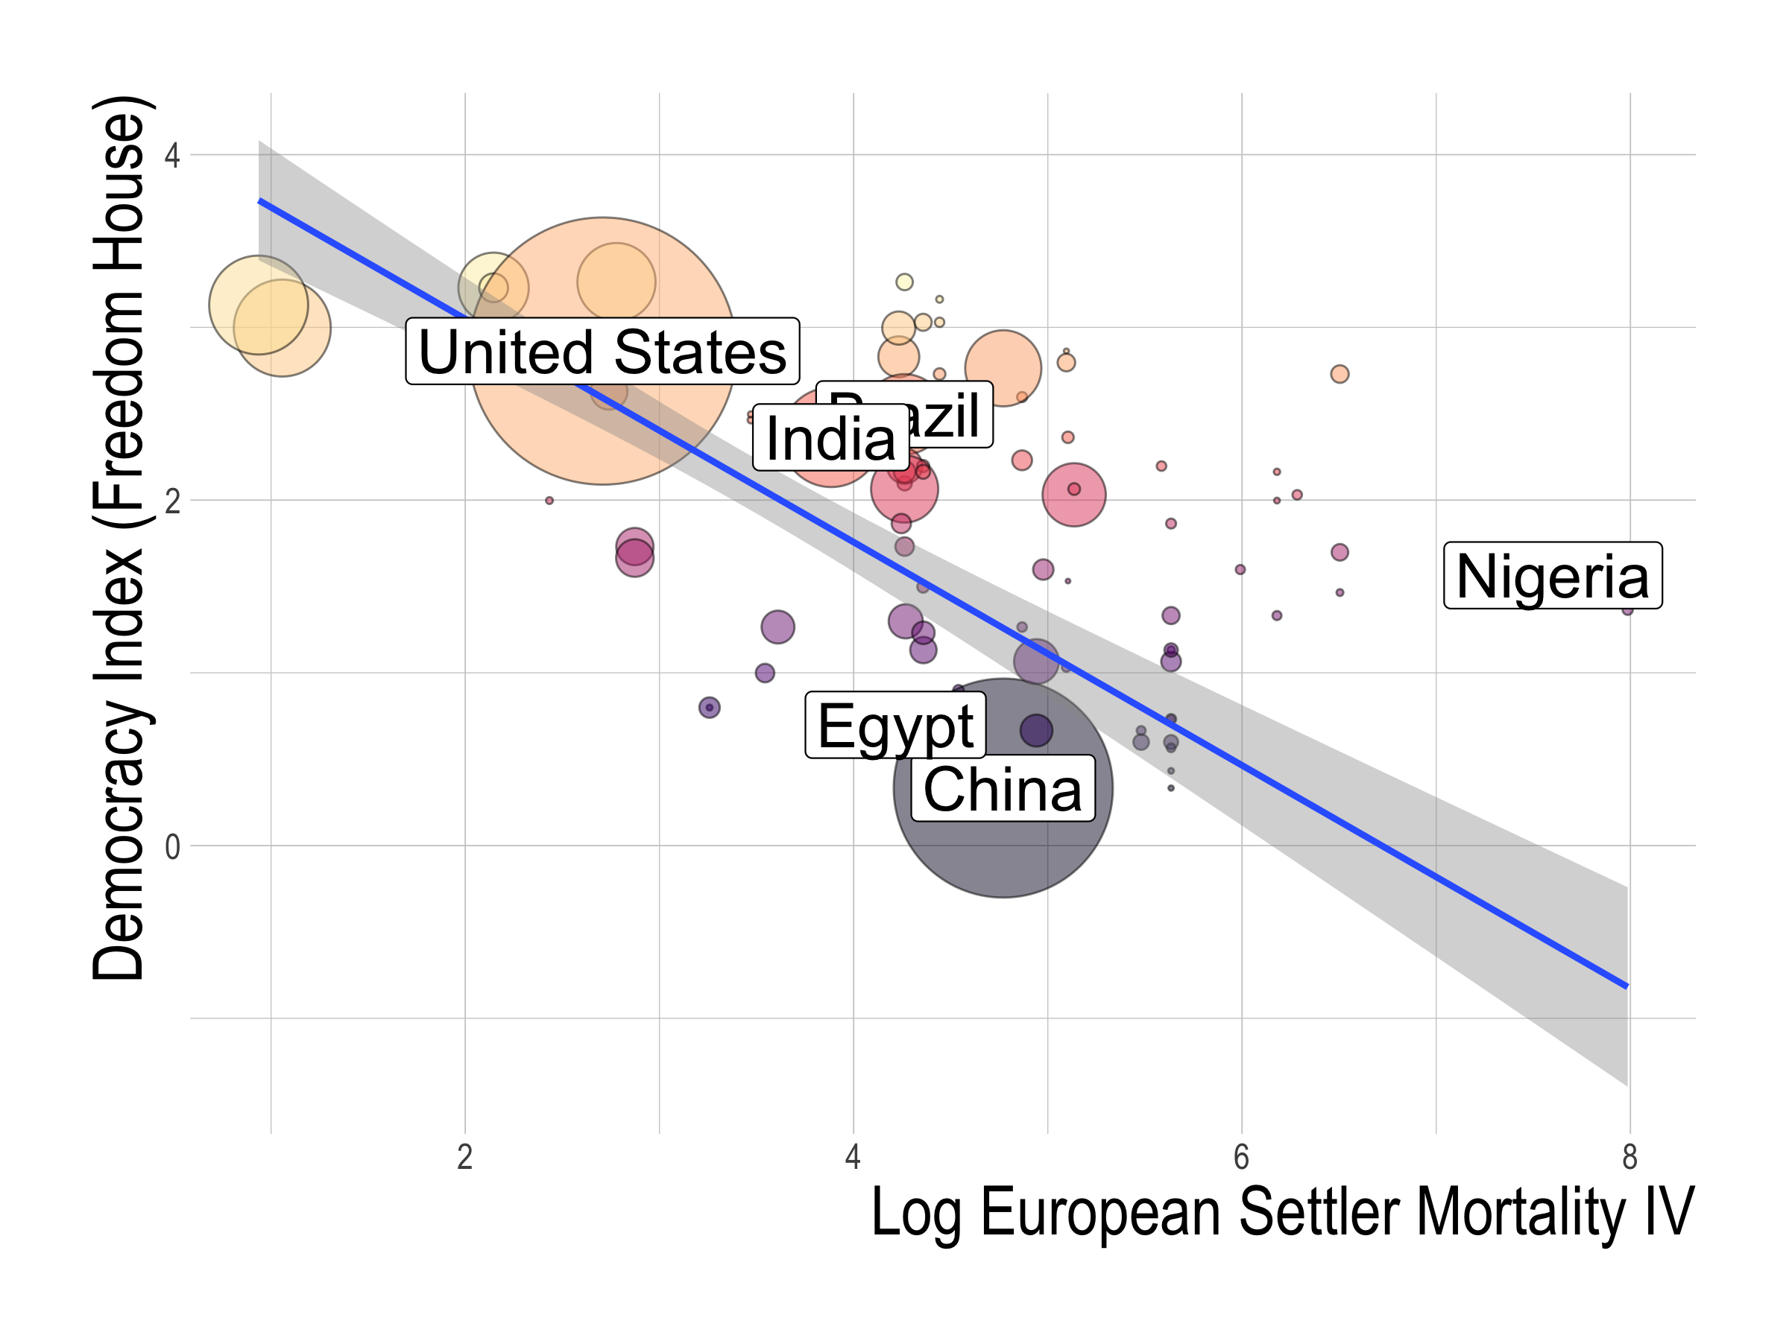
Higher European settler mortality
Less European settlers
More extractive colonial institutions
Less democractic political institutions
Notes:
This historic interpretation can be confirmed directly in our data, where higher European settler mortality rates is significanlt associzted with lower levels of democracy today.

Slide 31
2. Fraction speaking English or European and the Frankel-Romer trade share as IVs
Hall and Jones (1999)
Fraction speaking English or European: fraction of a country’s population speaking English or a major Western European language (French, German, Portuguese, or Spanish) as a mother tongue in 1992
Frankel-Romer trade share: the predicted trade share of each country’s economy, based on the gravity model of international trade
Notes:
Our second instrumental variables strategy uses a set of three instruments proposed by Hall and Jones that consist of the fraction speaking English or European, and the Frankel-Romer trade share.
The fraction speaking English or European is the fraction of a country’s population speaking English or a major Western European language (French, German, Portuguese, or Spanish) as a mother tongue in 1992.
The Frankel-Romer trade share is the predicted share of each country’s economy occupied by international trade, based on the gravity model. Put simply, this gravity model considers a country’s geographic characteristics, such as its distance from neighboring countries to estimate how susceptible a country’s geography is to international trade.
But how are these valid instruments?

Slide 32
Higher Fraction
Speaking European
Western European
Influence
More democractic political institutions
Notes:
First, lets think about the fraction speaking European.
A major feature of world history is the spread of Western European influence. This influence created an institutional and cultural background conducive to Western democracy. The language variables act proxies for such Western influence.

Slide 33
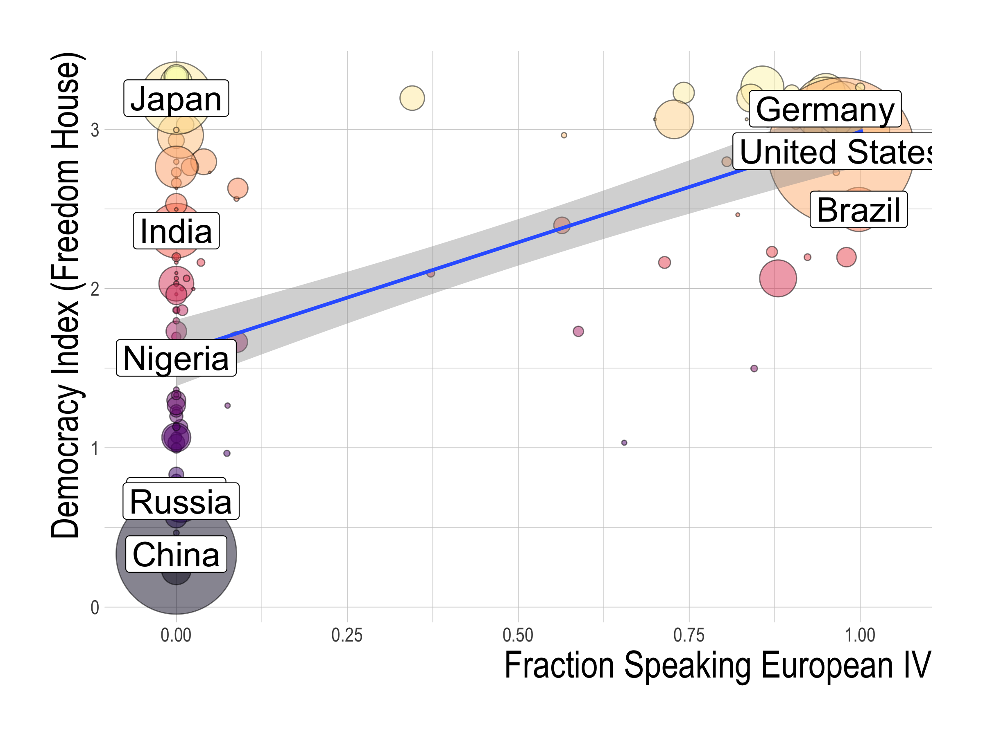
Higher Fraction
Speaking European
Western European
Influence
More democractic political institutions
Notes:
First, lets think about the fraction speaking European.
A major feature of world history is the spread of Western European influence. This influence created an institutional and cultural background conducive to Western democracy. The language variables act proxies for such Western influence.
Indeed, we can confirm in our data that higher fractions of the population speaking European correspond to higher levels of democracy today.

Slide 34
Frankel-Romer
Trade Share
Geographic Characteristics
Propensity to
International Trade
Political Institutions
Notes:
For the Frankel-Romer trade share, as I mentioned, this trade share gives a score of how conducive a country’s geography is to international trade. Moreover, such ease of international trade is associated with the development of political institutions and rule-making that allow for trade.

Slide 35
3. Legal Origin
LaPorta, Shleifer, and Vishny (1998)
Dummy variables that are turned on if the country’s legal origin is English, French, or German.
Legal
Origin
Legal
Infrastructure
Political
Regimes
Notes:
Our third instrument is legal origin, suggested by LapPorta, Shleifer, and Vishny.
These are dummy variables that are turned on if the country’s legal origin is English, French, or German.
Why are these valid instruments?
Many countries derived their legal systems from colonization by one of these European powers.
Such legal origin determined the general legal infrastructure and influenced how the law protects civil liberties and political rights today, which is significantly correlated with political regimes.
By having separate dummies for legal origin, we allow them to have varying effects on political institutions today.

Slide 36
4. Availability of crops and minerals
Easterly and Levine (2003)
Dummy variables for whether a country produced or mined a particular commodity in 1990.
Bananas, coffee, copper, maize, millet, rice, rubber, silver, sugarcane, wheat.
Economies
of scale
& slave labor
Crops and minerals
Political
Regimes
Notes:
Our forth instrument is the availability of crops and minerals, suggested by Easterly and Levine.
These are dummy variables for whether a country produced or mined a particular commodity in 1990.
These commodities are bananas, coffee, maize, millet, rice, rubber, sugarcane, and wheat.
These act as valid instruments because, according to historians such as Engermann and Sokoloff, certain commodities encouraged or discouraged economies of scale and the use of slave labor, which led to more inclusive or extractive institutions that laid the groundwork for today’s political regimes.

Slide 37
5. Past Population Density
Acemoglu, Johnson and Robinson (2002)
Number of inhabitants per square kilometer in the 16th century.
Population
Density in 16th century
Colonial
Institutions
Political
Regimes
Notes:
Our fifth instrumental variable strategy uses past population density, as suggested by Acemoglu, Johnson, and Robinson. This variable records the number of inhabitants per square kilometer in the 16th century.
It works as an instrument because population density at the beginning of the 16th century determined how inclusive or exclusive colonial institutions were.
Sparse populations induced Europeans to settle themselves and develop more inclusive colonial institutions.
On the other hand, more dense local populations meant more slave labor and more wealth to extract, which resulted in more exclusive colonial institutions.
The effect of these colonial institutions persist to the present.

Slide 38
Instruments for political regimes
Five IV strategies:
European settler mortality
Fraction speaking English or European and the Frankel-Romer trade share
Legal origin
Availability of crops and minerals
Past population density
Our strategy: the strategies work as robustness checks against each other.
Notes:
We are aware that none of these IVs is perfect.
Each IV is likely to be threatened by its own mix of measurement errors, omitted variables, and exclusion violations.
Hence, our strategy is to use these five different IVs with the expectation that they work as robustness checks with each other.

Slide 39
Outline
Data on GDP, Covid-19 deaths, and democracy
OLS relationship between democracy, GDP, and Covid-19 deaths
Instruments for political regimes
Results
Democracy’s causal effect
Channels behind democracy’s effect
Conclusion
Notes:
Now, we would like to move on to describing our findings on democracy’s causal effect.
We will first show the results of our reduced form regressions.

Slide 40
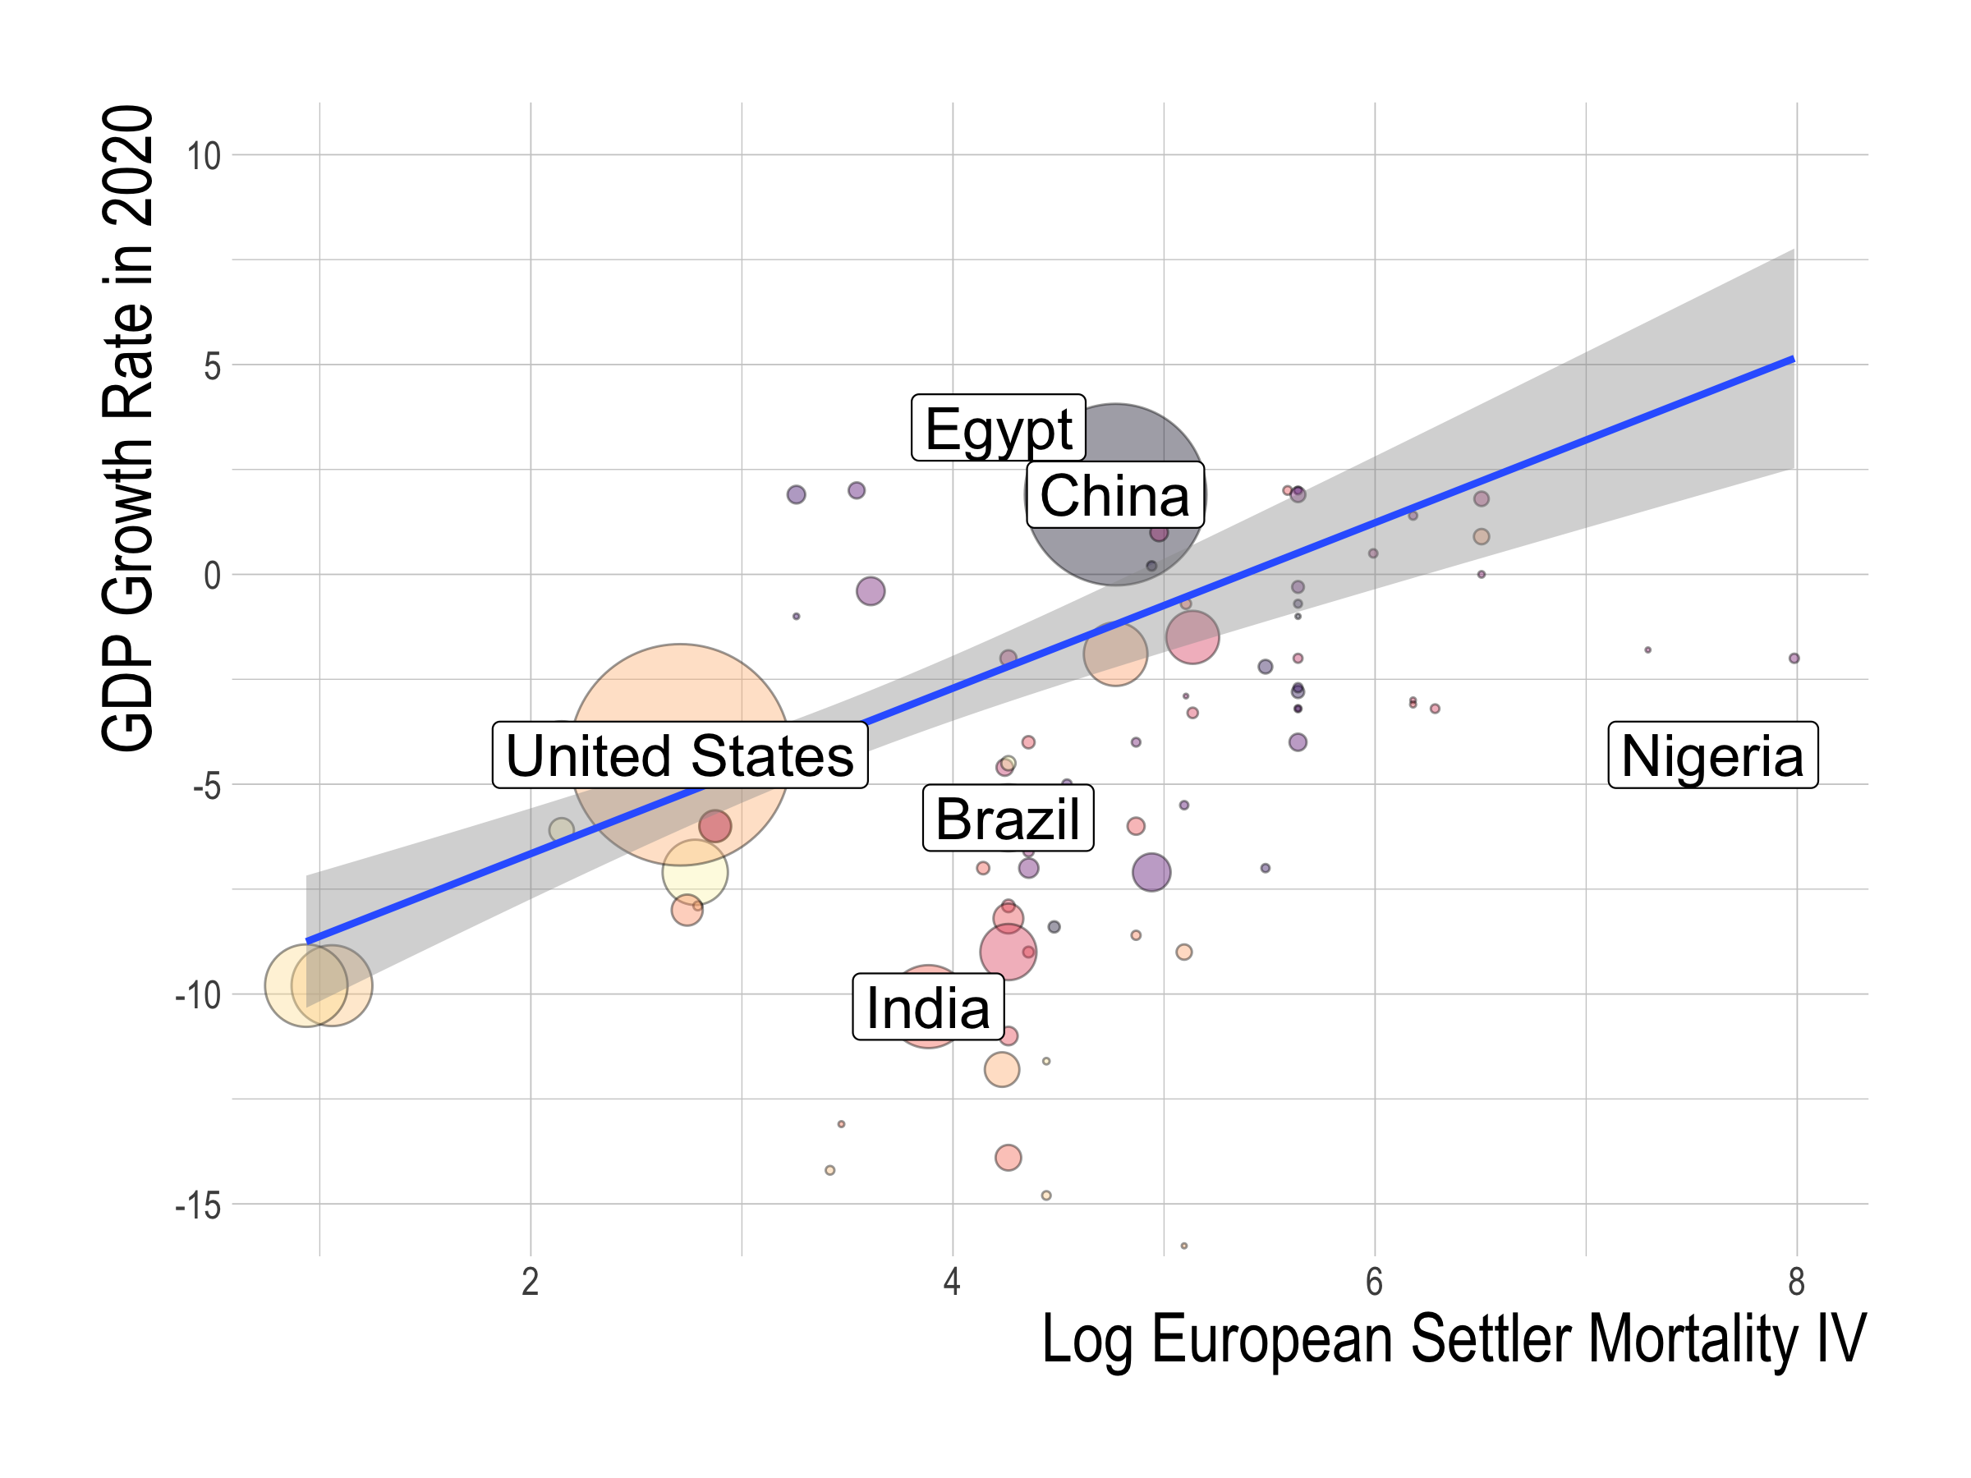
Lower European settler mortality
More democractic political institutions
Lower GDP growth in 2020
Notes:
This is the reduced form figure with European settler mortality on the x-axis and the GDP growth rate in 2020 on y-axis.
We can observe that lower european settler mortality is significantly associated with lower GDP growth rates in 2020. This shows that democracy did caused the worse economic outcomes in 2020 because lower European settler mortality is associated with more democratic political institutions.

Slide 41
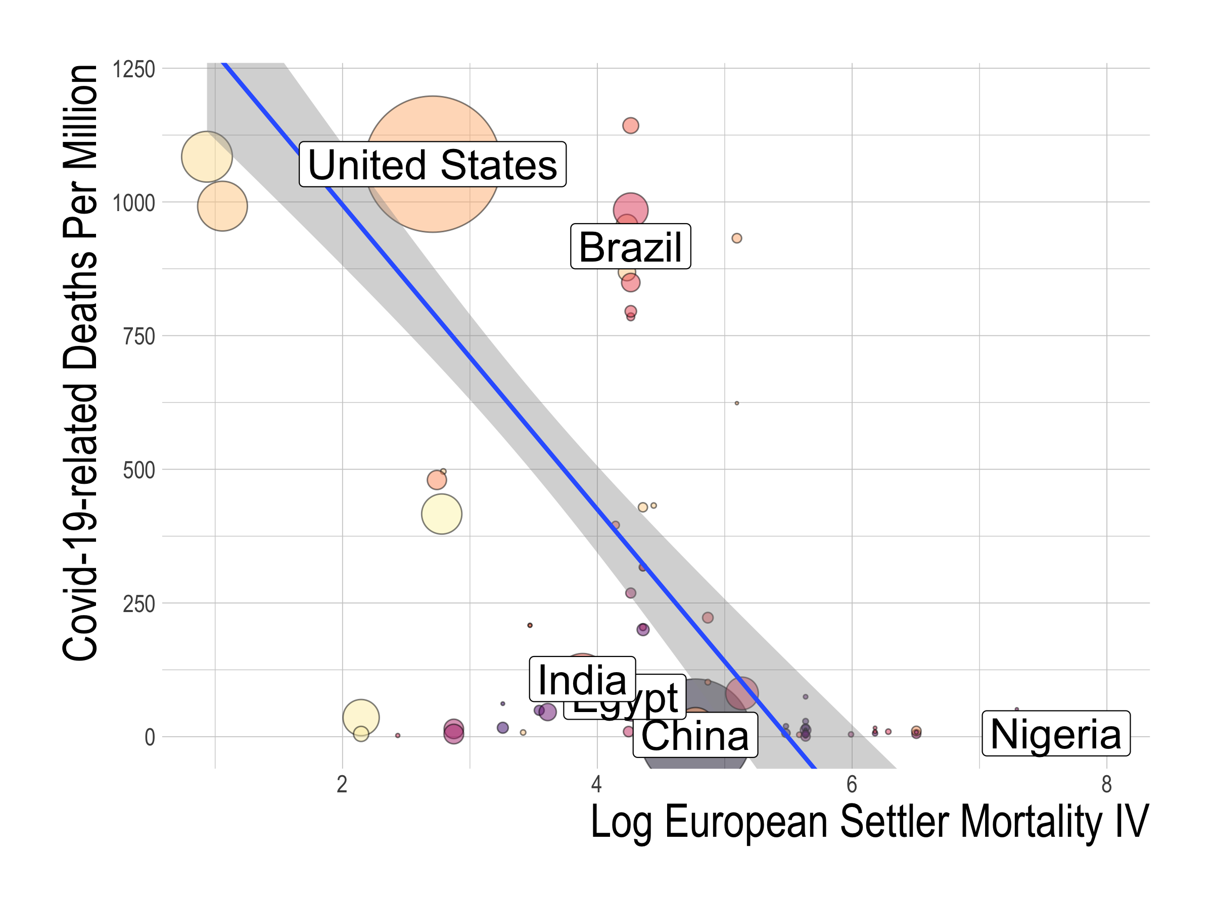
Lower European settler mortality
More democractic political institutions
More Deaths
from Covid-19
Notes:
We also similarly confirm a negative causal effect of democracy with the reduced figure with European settler mortality on the x–axis and Covid-19 deaths per million on the y-axis.
The fact that we observe that lower settler European mortality is associated with more deaths from Covid-19, confirms that more democratic institutions, which are correlated with lower European settler mortality, did cause more deaths from Covid-19.

Slide 42
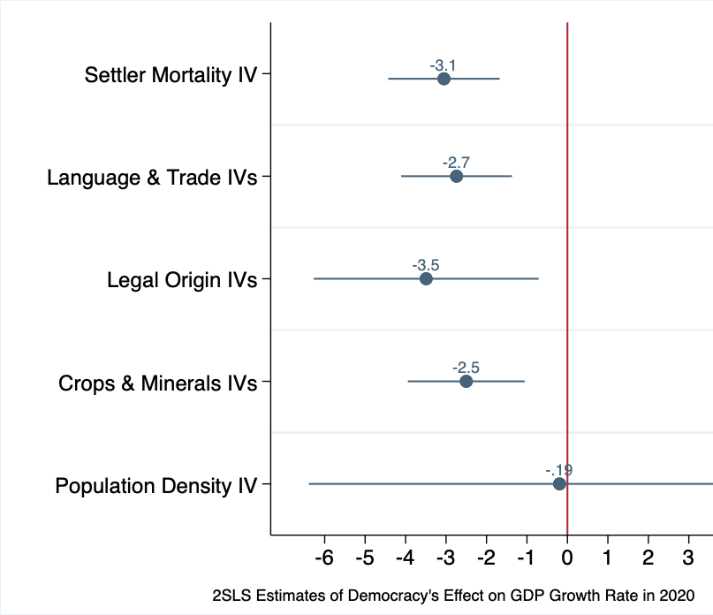
Notes:
How large were these effects?
Here we show the 2 stage least squares estimates of the effect of democracy on GDP growth rates, under five instrumental variable strategies that we described. The line corresponds to the 95% confience interval.

Slide 43
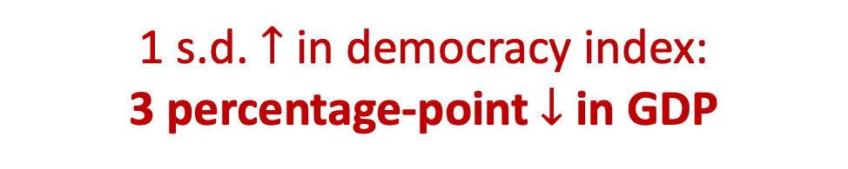
1 s.d. $↑$ in democracy index:
3 percentage-point $↓$ in GDP
Notes:
What we find is that a standard deviation increase in the democracy index (again, as a benchmark, this is equivalent to the political regime difference between Iraq and Indonesia, or Indonesia and France), is caused around a 3 percentage-point decease in GDP between 2019 and 2020.
This is fairly significant effect, given that the average global GDP growth rate in 2020 is -5.7%.

Slide 44
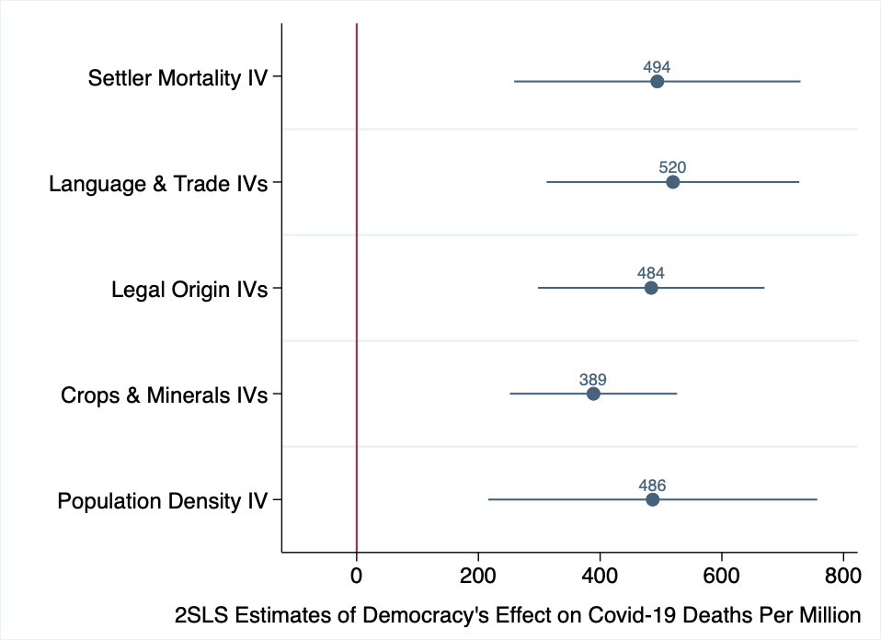

1 s.d. $↑$ in democracy index:
400 $↑$ Covid-19 related
deaths per million
Notes:
We also find a significant causal effect of democracy on Covid-19 deaths per million.
We find that a standard deviation increase in democracy levels caused around a 400 increase in Covid-19-related deaths per million.
As we can see, this result is consistent across the give instrumental variable strategies.
Moreover, this result again implies that democracy is a significant determinant of Covid-19 deaths, given that the global average of Covid-19-related deaths per million is 285.

Slide 49
Robustness
Add controls
climate (absolute latitude, mean temperature, mean precipitation)
population density
population ageing
diabetes prevalence
service sector share
Use alternative democracy indices
Use alternative weightings
Exclude US and China from sample
Notes:
Although we do not have time to go into detail today, in our paper, we show that our results are robust to various specifications.
The addition of controls such as climate, population density, population ageing, diabetes prevalence, or service sector share, all of which are plausible determinants of Covid-19 outcomes, does not change our baseline results of a negative effect of democracy.
Neither does using alternative democracy indices, or alternative weighting methods, change our results.
We also establish that our result is a global phenomenon and not driven by US and China alone, by showing that we get similar results even when excluding the US and China from the sample.

Slide 50
Outline
Data on GDP, Covid-19 deaths, and democracy
OLS relationship between democracy, GDP, and Covid-19 deaths
Instruments for political regimes
Results
Democracy’s causal effect
Channels behind democracy’s effect
Conclusion
Notes:
Now, we know that democracy did cause the worse outcomes. This begs the question of how. What were the main mechanisms behind democracy’s effect?

Slide 51
“Catastrophically slow and inadequate” policies at the beginning of the pandemic
Paul Krugman. “3 Rules for the Trump Pandemic.”
New York Times.
Notes:
Media and policy discussions point to the severity, coverage, and speed of containment policies as potential proximate mechanisms. Indeed, Paul Krugman, in his article for the New York Times, blames ”catastrophically slow and inadequate policies” at the beginning of the pandemic for the US’s failure to mitigate the effects of the virus.

Slide 52
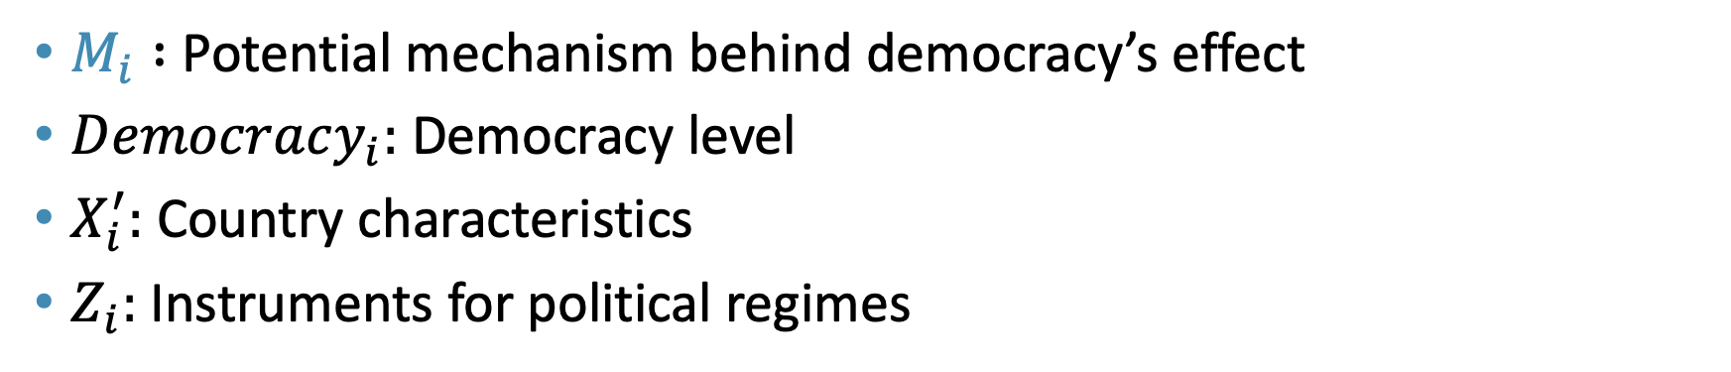
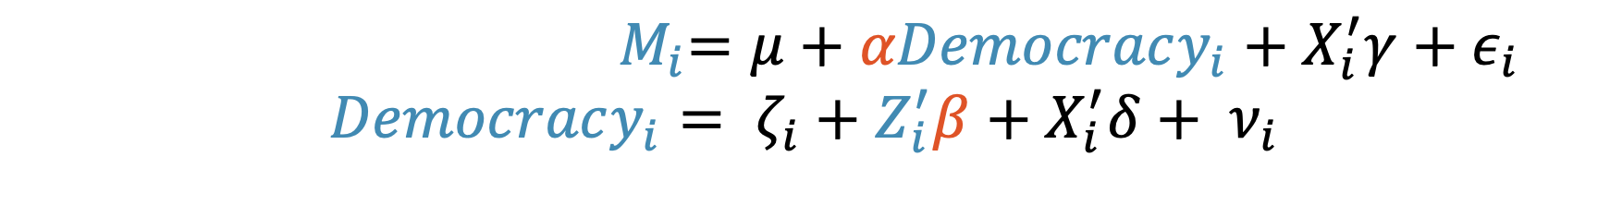
Empirical specification
${ M}_{i}=μ+αDemocracy_{i}+X_{i}^{′}γ+ε_{i}$
$$Democracy_{i}= ζ_{i}+Z_{i}^{′}β+X_{i}^{′}δ+ ν_{i}$$
$M_{i} :$ Potential mechanism behind democracy’s effect
$Democracy_{i}:$ Democracy level
$X_{i}^{′}:$ Country characteristics
$Z_{i}:$Instruments for political regimes
Notes:
To explore this empirically, we use the following familiar specification, where we replace our outcome variable Y with M, which represents the potential mechanism behind democracy’s effect.
////Our empirical specification is as follows:
The equation at the top, which is our second-stage equation, is the same as our OLS equation, where we have Covid-19 outcomes on the left side, and our main explanatory variable, democracy levels, on the right hand side.
The difference now is that, since democracy is far from randomly assigned, we introduce a first-stage equation that has democracy as the outcome variable and instruments for political regimes, captured by Z, as the main explanatory variable.

Slide 53
Data on Policy Responses
Panel data from the Oxford COVID-19 Government Response Tracker (OxCGRT)
Tracks policy responses in 160 countries.
Notes:
We source panel data on policy responses from the Oxford Covid-19 government response tracker, abbreviated as OxCGRT.
This database tracks daily all the policies related to Covid-19 taken by 160 countries, as well as how severely and widely they are imposed within each country.

Slide 54
Mechanisms for democracy’s effect
More democratic political regimes caused…
Weaker responses
Narrower coverage of responses
Slower responses
Key channel for democracy’s effect:
weaker and narrower containment policies
not the speed of policy implementation
Notes:
To give a preview, what we find is that more democratic political regimes caused weaker and narrower coverage of responses, but NOT slower responses.
Hence, this suggests that the key channels for democracy’s effect are weaker and narrower containment policies, and but the speed of policy implementation.

Slide 55
1. Severity of policy
OxCGRT’s Containment Health Index
summarizes the severity and scope of government measures
rates responses across various aspects of civilian life
Use the Containment Health Index at 10th confirmed case of Covid-19
Notes:
The first channel we explore is severity of policy responses and whether democracy caused weaker responses.
To measure severity, we use the OxCGRT dataset’s containment health index.

Slide 56
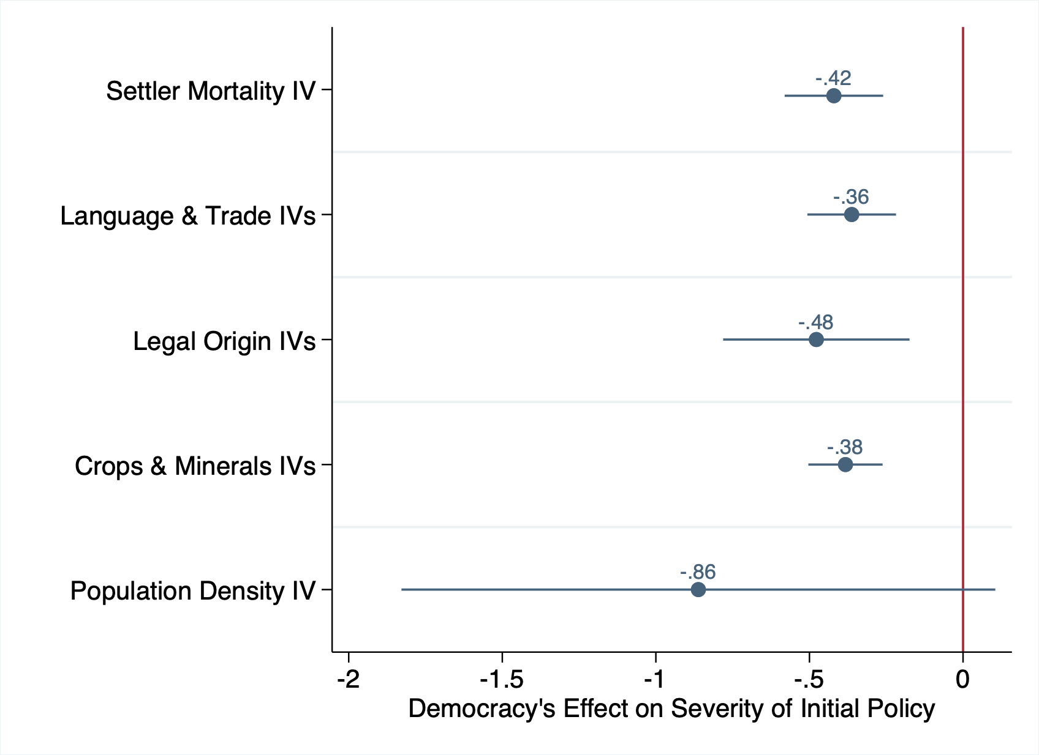
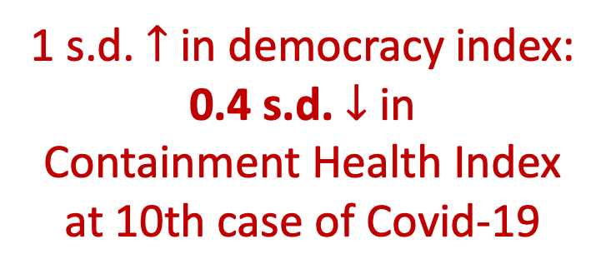
1 s.d. $↑$ in democracy index:
0.4 s.d. $↓$ in
Containment Health Index
at 10th case of Covid-19

Slide 57
2. Coverage of policy
% of 13 domains in which the government introduced significant containment measures at the 10th confirmed case of Covid-19
The 13 domains are: schools, workplaces, public events, gatherings, public transport, stay-at-home requirements, domestic travel, international travel, public information campaigns, testing, contact tracing, facial coverings, and vaccinations.

Slide 58
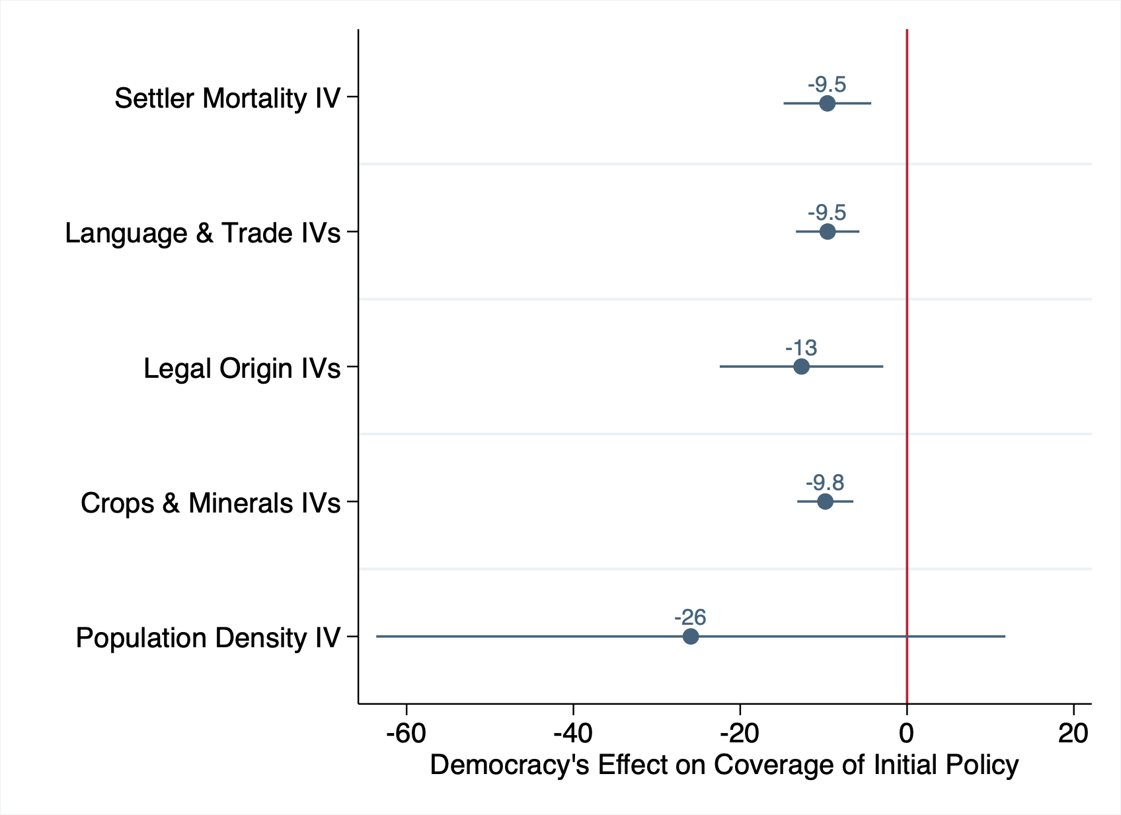
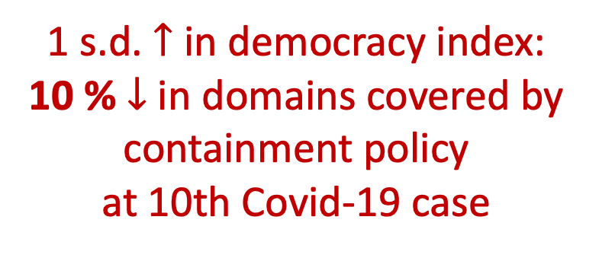
1 s.d. $↑$ in democracy index:
10 % $↓$ in domains covered by containment policy
at 10th Covid-19 case

Slide 59
3. Speed of policy
Number of days between the 10th confirmed case and the introduction of any containment policy.

Slide 60
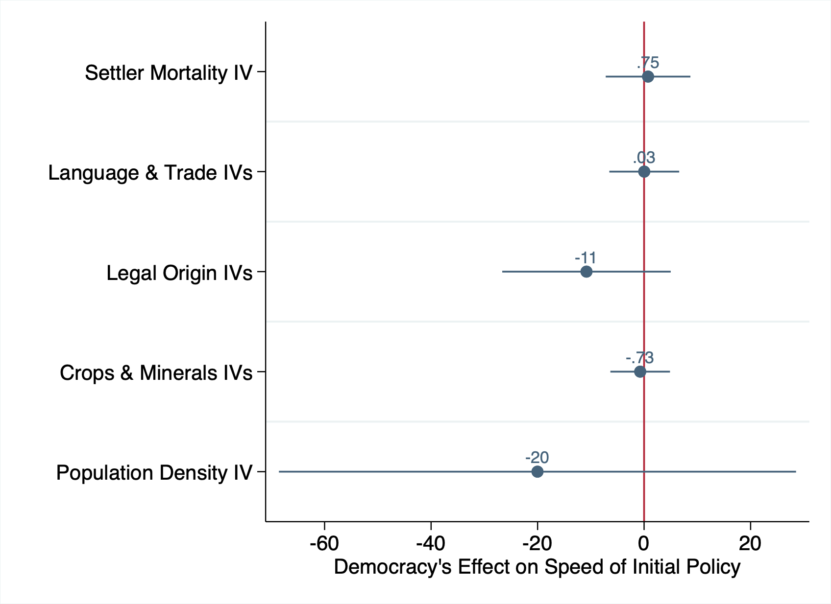
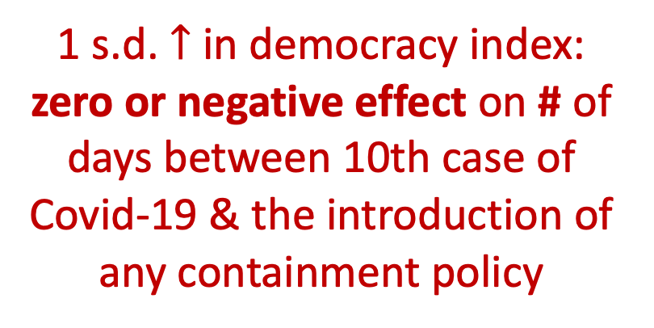
1 s.d. $↑$ in democracy index:
zero or negative effect on # of days between 10th case of Covid-19 & the introduction of any containment policy

Slide 61
Results on mechanisms
More democratic political regimes caused…
Weaker responses
Narrower coverage of responses
Slower responses

Slide 62
Interpretation of results on mechanisms
Democratic regimes lead to weaker incentives and authority to enforce decisive, wide-ranging containment policies
Such policies are often unpopular, especially at the beginning of the pandemic
Notes:
How do we interpret our results on mechanisms?
The results imply that democratic regimes lead to weaker incentives and authority to enforce decisive, wide-ranging containment policies.
This is because such policies are often unpopular among voters, especially at the beginning of the pandemic, when the scope of the crisis was still uncertain.
This lack

Slide 63
Outline
Data on GDP, Covid-19 deaths, and democracy
OLS relationship between democracy, GDP, and Covid-19 deaths
Instruments for political regimes
Results
Democracy’s causal effect
Channels behind democracy’s effect
Conclusion
Notes:
Now, let’s describe the OLS relationship between democracy and Covid-19 outcomes.

Slide 64
Curse of Democracy: Evidence from 2020
We found that:
Democracy dampens economic growth and causes more Covid-19-related deaths in 2020
Mechanism likely to be weaker and narrower containment policies

Slide 65
Curse of Democracy: Evidence from 2020
Moving forward:
Better outcome data?
Democracy’s effects on perfomance in other aspects?
Inequality
Happiness and well-being
Geopolitical movements away from democracy?

Slide 66
Curse of Democracy: Evidence from 2020
Policy Implication:
Not a general case against democracy
normative and procedural virtues
democracies may be better in the long run
Preferred interpretation:
Democracy has room for improvement in particular aspects in particular situations

Slide 67
“We all know what to do, we just don’t know how to get re-elected after we’ve done it.”
Jean-Claude Juncker
President of the European Commission (2014-2019)

Slide 69
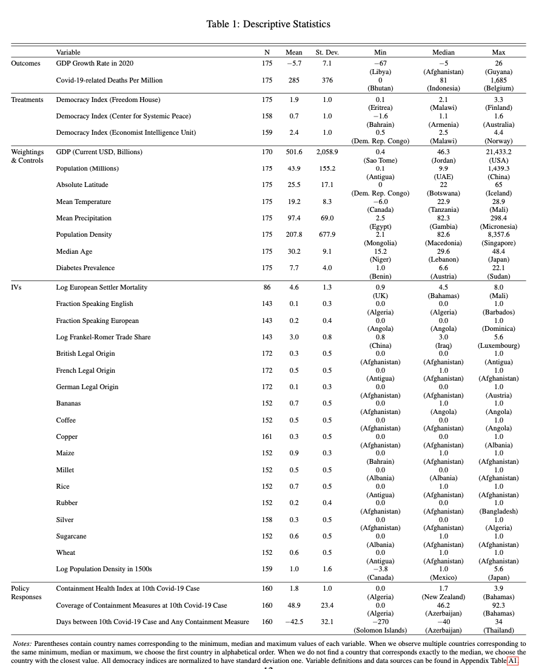

Slide 70
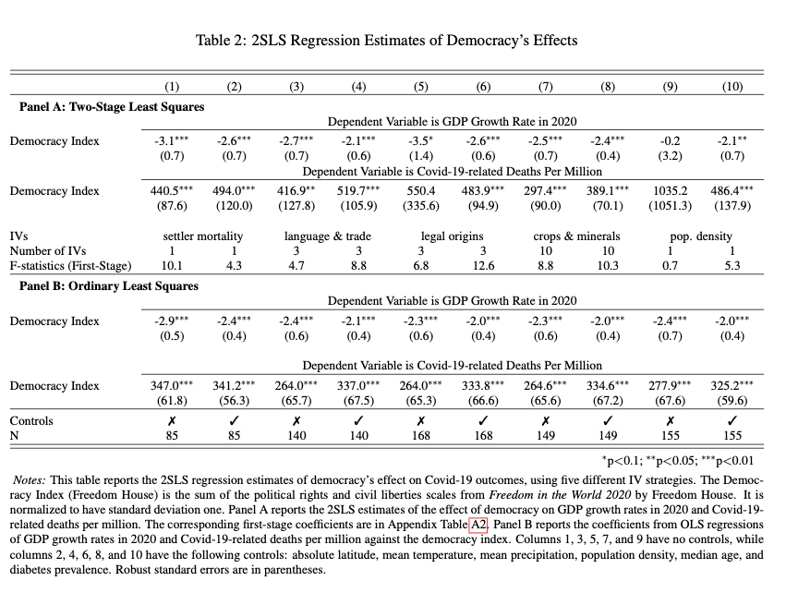

Slide 71
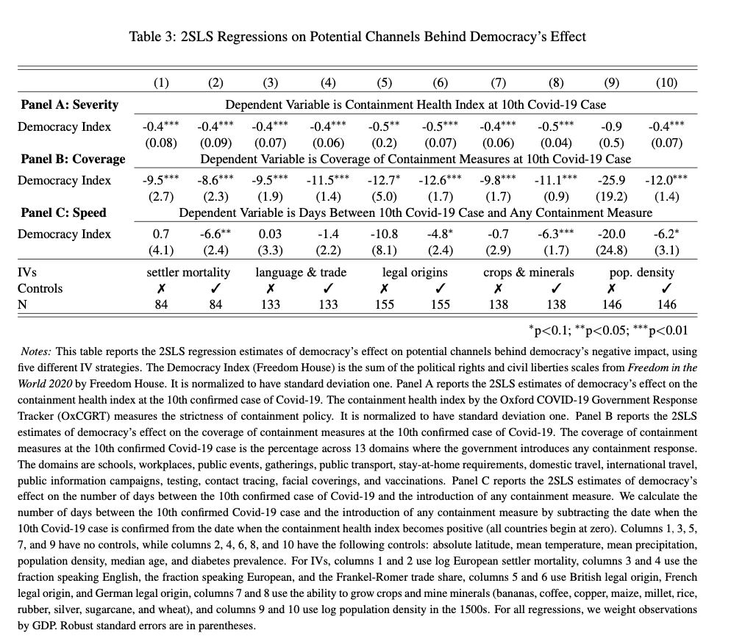

Slide 72
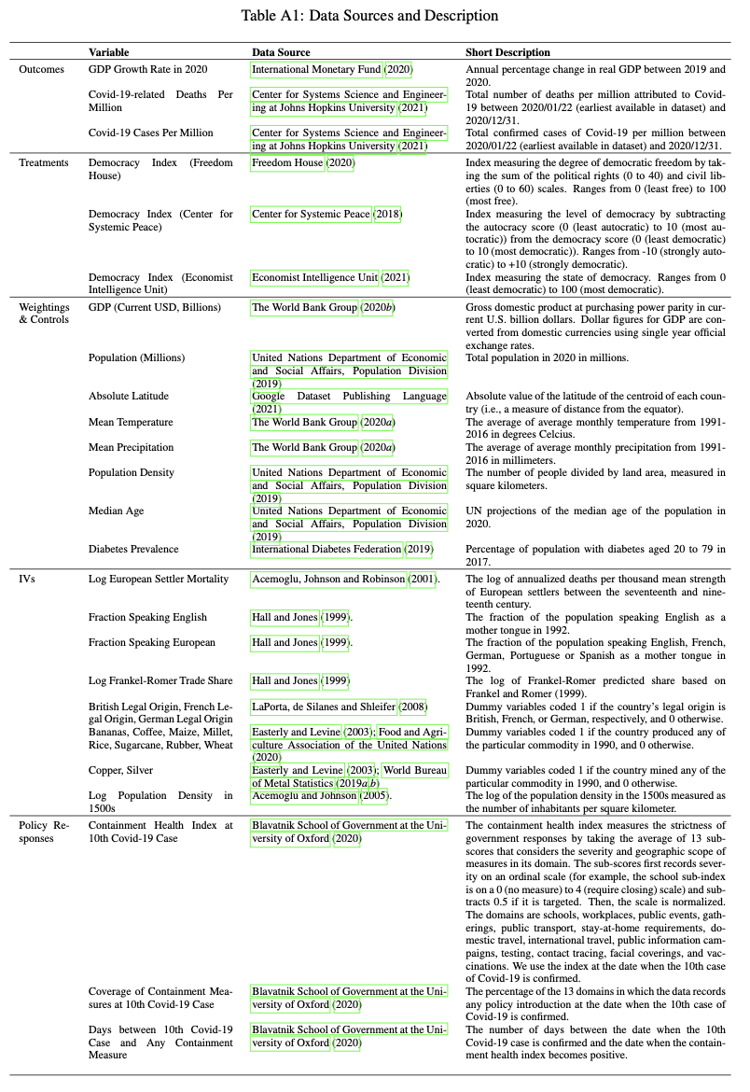

Slide 73
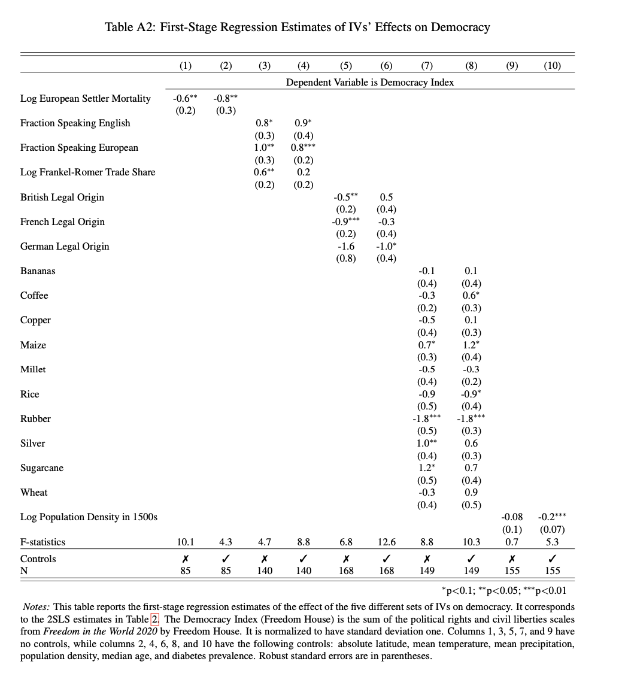

Slide 74
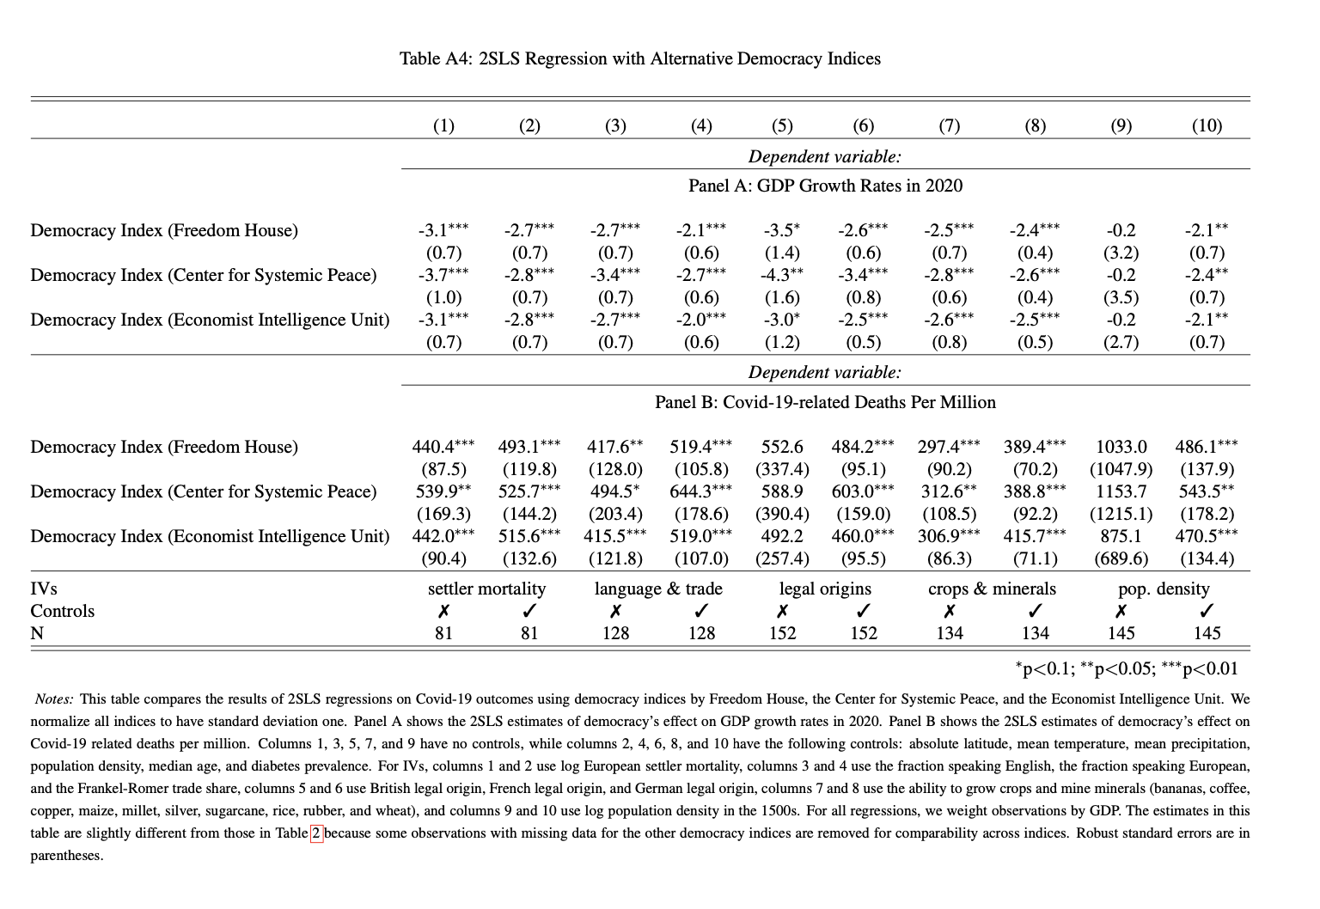

Slide 75
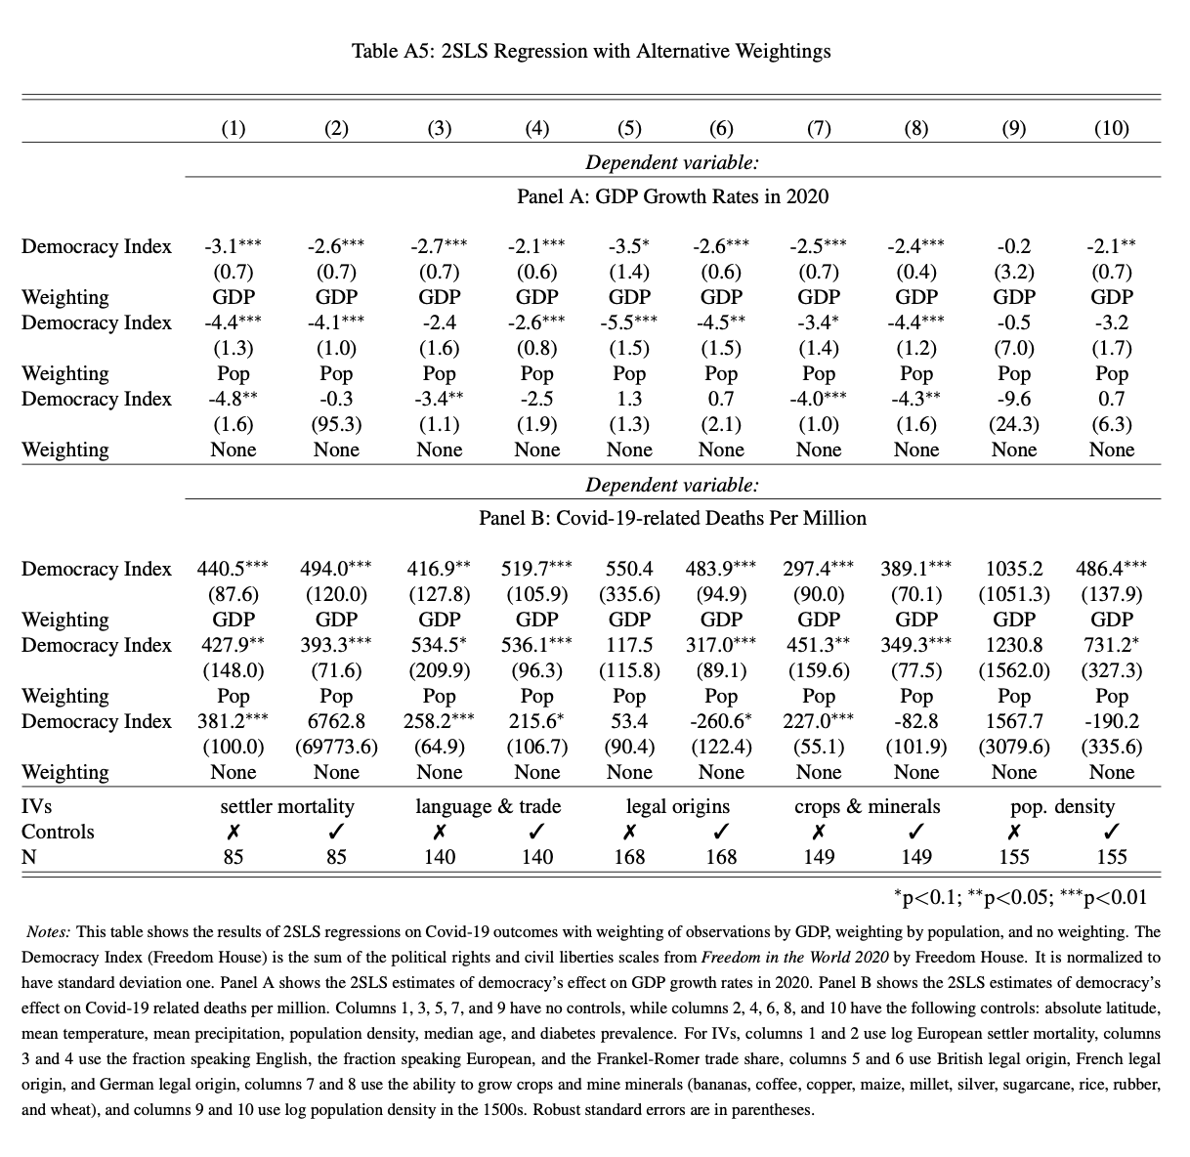

Slide 76
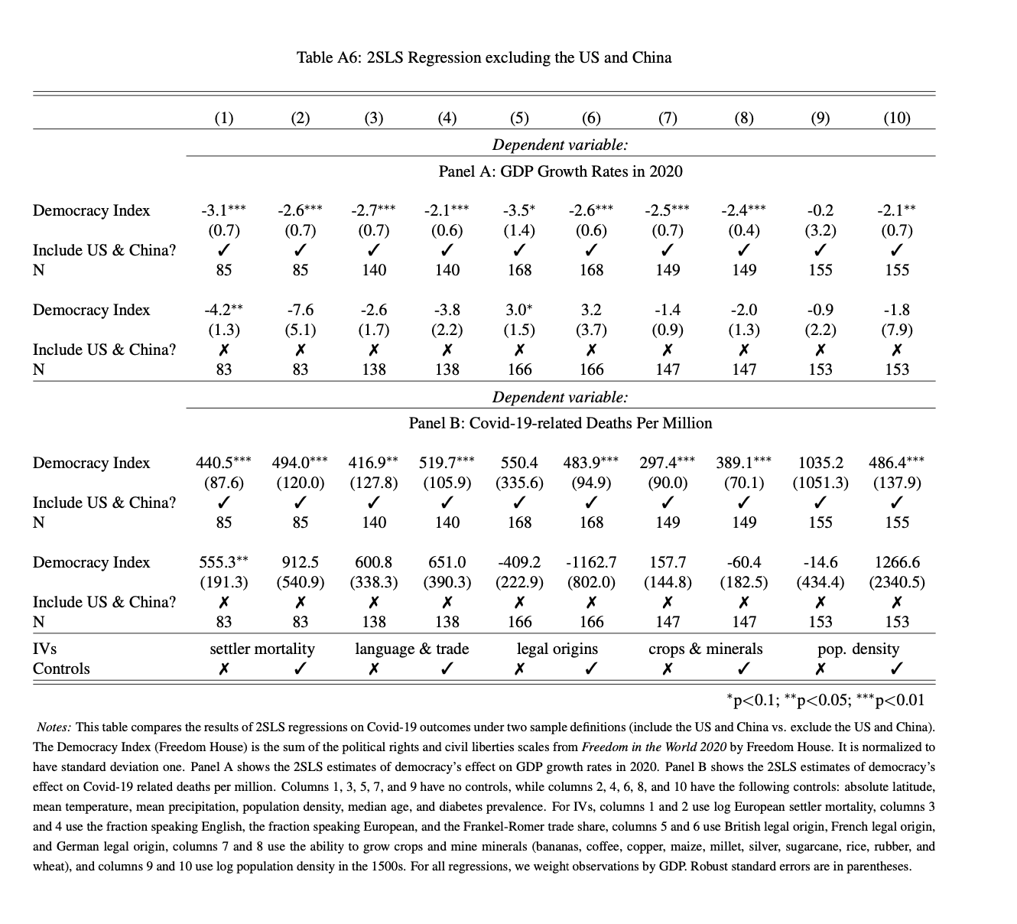

Slide 77
